Slide 1
Training On Multi-sector Initial Rapid Assessment (MIRA)

Slide 2
Objectives of MIRA module
2
On completion of this workshop, you should be able to:
Know importance of assessments in emergencies
Describe type of information required in emergency situation
Understand global as well as national experiences and lesson learned
Comprehend quick snapshot of humanitarian situation
Assist decision makers to comprehend nature & dynamics of disaster
Identify strategic humanitarian priorities for timely response & resource mobilization
Efficient, smooth & effective survey to identify
Priority needs
Scale and extent of disaster
Gaps in response

Slide 3
Content of MIRA module
Session 1: Assessment in Emergencies
Session 2: Overview of MIRA

Slide 4
Assessment in Emergencies
Session-1

Slide 5
Objectives of Session 1
5
By end of this session, you should be able to:
Know importance of assessments in emergencies
Describe type of information required in emergency situation
Understand Global as well as national experiences and lesson learns

Slide 6
Content of Session 1
6
Assessment in Emergency- Scenarios
Brainstorming / Open Discussion

Slide 7
Assessment in Emergencies - Scenario
7
Monsoon floods hit several district of Azad Jammu and Kashmir, Punjab, and Sindh. Rawalakot, Bagh and Muzaffarabad are worse affected district in AJK.
Kashmore, Shikarpur and Jacobabad in Sindh whereas Multan, Jhang and Muzaffargarh in Punjab are also affected
Media as well as districts authorities reported high level of damages

Slide 8
Assessment in Emergencies - Scenario
8
Majority of population is sitting shelter less in open fields/roads. Pakistan army, PDMA and local NGOs have started initial response
Federal government decide to develop Emergency Response Plan to ensure harmonized and well-managed relief activities. For that purpose, availability of information is critical. you are tasked to design a quick rapid assessment.

Slide 9
Assessment in Emergencies
9
Please identify:-
What type of information will be required
What would be the most important information source
How the data will be collected, analyzed and presented
Timeline of all the activities

Slide 10
Assessment in Emergencies – Group Work Presentation
10
Conclusion:-
Availability of accurate and timely information is critical at every stage of DRM
Information need varies at every stage of disaster
Notes:
MIRA deals with information collection just after the disaster,
Lets move ahead to find the answers to above questions

Slide 11
Overview of Multi-sector Initial Rapid Assessment (MIRA)
Session-2
Notes:
Q:1 Have you ever hear about the MIRA? Or Have you ever part of the MIRA exercise?

Slide 12
Objectives of Session 2
12
By end of this session, you should be able to:
Quick snapshot of humanitarian situation
Assist decision makers to comprehend nature & dynamics of disaster
Identify strategic humanitarian priorities for timely response & resource mobilization
Efficient, smooth & effective survey to identify
Priority needs
Scale and extent of disaster
Gaps in response
Notes:
Provides snapshot and common understanding of the humanitarian situation for the natural disasters
Assist decision makers to comprehend:
nature,
dynamics,
scale and scope of the disaster.
3. Identify strategic humanitarian priorities for timely response & resource mobilization
4. Strategic decision making (e.g. response plan, flash appeal, international assistance etc.).
Response strategy and priorities such as to initiate response , adjust ongoing response, and to monitor the situation.
Quick snapshot of humanitarian situation
Assist decision makers to comprehend nature & dynamics of disaster
Identify strategic humanitarian priorities for timely response & resource mobilization
Efficient, smooth & effective survey to identify
Priority needs
Scale and extent of disaster
Gaps in response

Slide 13
Content of Session 2
13
MIRA Background
MIRA Prioritized Sectors
MIRA Initiation Process
Team composition / Coordination Structure for MIRA
Three Phases of MIRA
MIRA Process timeline
Key Informant
Identifying Key Informant
Key Informant Selection Criteria
Direct observations (Structured and unstructured)
Data Collection Tools
Key informant Questionnaire
Direct Observation Checklist
Interview Do’s and Don’ts
MIRA in Action (snapshot from previous MIRA exercises)

Slide 14
MIRA Background
14
Globally adopted tool for scientific, quick & accurate disaster assessment
NDMA & Humanitarian Country Team agreed to develop Assessment & Monitoring Framework in 2012
MIRA proved an extremely effective tool after floods 2012 & 2014 in Pakistan
Lessons learned : lack of trained enumerators, lack of validation mechanism
Notes:
Types of Disaster. The types of disaster covered under these Guidelines include flood, earthquake, tsunami, drought, sediment disaster, avalanche, Glacial Lake Outburst Flood (GLOF), cyclone, wind/ hailstorm, hurricane, tropical storms, tornados, heatwave, landslide, lightning as well as man-made disasters including Industrial/urban/forest fire, chemical, biological, radiological or nuclear accidents etc.

Slide 15
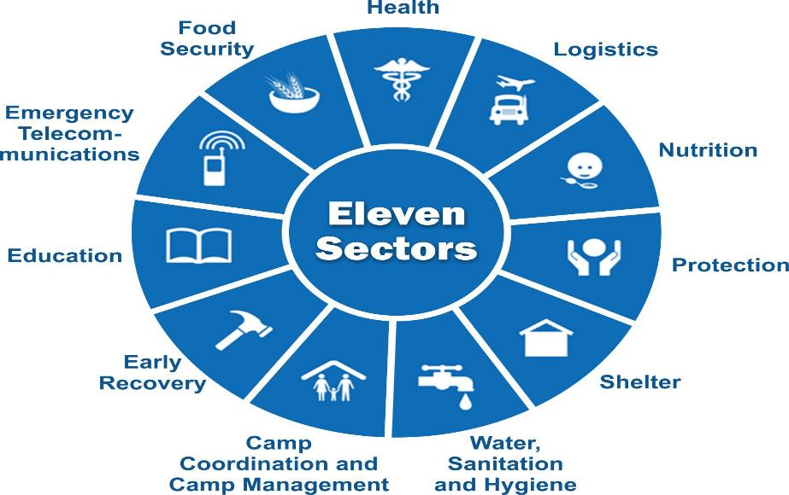
MIRA – Sectors Covered
15
Notes:
Q:3 Which sectors are covered in the MIRA?

Slide 16
MIRA – Initiation Process
16
Extreme intensity disaster (s) with Medium, High or Mega intensity
Concerned DMAs will declare intensity of disaster & request NDMA for MIRA
Final decision by NDMA in consultation with all stakeholders
NDMA & UNOCHA will coordinate with relevant DMAs & humanitarian partners to support implementation

Slide 17
MIRA – Team Composition / Coordination Structure
17
Assessment Working Group: Assessment Working Group overall coordinating and implementing body to coordinated assessment activities
Assessment Technical Team: TT assists the AWG in development of methodologies and tools, Provide technical advice, Analyze data. Facilitate use of technology. Technical support to implement MIRA
Joint Assessment Roster: support the MIRA process in primary data collection –field work
Notes:
Page 6
Next: MIRA process have three phases.

Slide 18
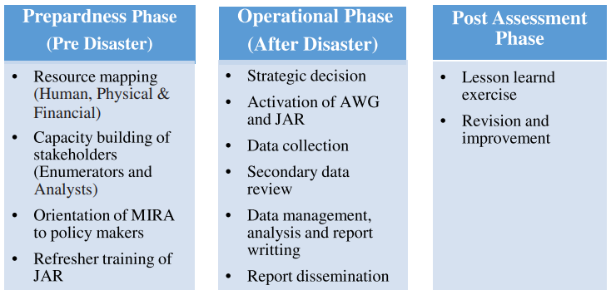
MIRA – Process (Three Phases)
18

Slide 19
19

Slide 20
PRIMARY DATA COLLECTION TOOLS
Key informant Questionnaire

Slide 21
Key Informant
Individuals who are:
Well informed in their community or a particular group and its inhabitants
Examples: school administrators, hospital chief, local leaders, Government officials, women groups leaders, Female household heads, Children and Youth

Slide 22
Identifying Key Informant
Choose suitable key informants according to the purpose of the interview
A key informant can be any person who has a good understanding of the issue you want to explore
Can be a professional person who works with the group you want more information about, or a member of the target community
Key informants can be young or old, or from a variety of socio-economic levels or ethnic groups
Key informant can be holding formal position in the community

Slide 23
Key Informant Selection Criteria
Should be a respected and sound knowledgeable member of the community
Members of the community with special tasks in the community
Shura member, “Malik” (land measurements/book keeper),
“Patwar” (responsible for water and land),
“Midwife (Dai)” or traditional birth attendant,
Religious leader, community leader,
Leader of women's group,
Health workers,
School teachers, or
Social service representatives, etc.

Slide 24
Key Informant Selection Criteria
Should be a permanent member of the community (living in the community over at least 3 years on a permanent basis)
Have sound knowledge about community's demographics, issues and other social aspects of the community
Representatives of the minority groups in the community can also be interviewed if sizeable minorities exist in the area

Slide 25
PRIMARY DATA COLLECTION TOOLS
Group 1
Key informant
Group 2
Key informant
Group 3
Direct Observation
Key informant Questionnaire
Group 4
Direct Observation

Slide 26
Direct observation Checklist
PRIMARY DATA COLLECTION TOOLS

Slide 27
Direct Observation
Start observing from the get Go !!!
Look, hear, smell…..

Slide 28
Direct Observation
Observing conditions and specific features of an affected site from a range of viewpoints and locations to provide an overall view of the affected area and by noting these observations in a checklist.

Slide 29
- Road damaged
Proposed Assessment Site
People cutting trees
Forest
Total Distance
22 KM from Starting point
Estimate time of travel 35 Min at 60 KM average speed
5 KM
Market
8 KM
Markets Operational ?
Tomatoes, Potatoes available
Price ?
Access
Trade routes
Constraints
Assessment Team Starting Point

Slide 30
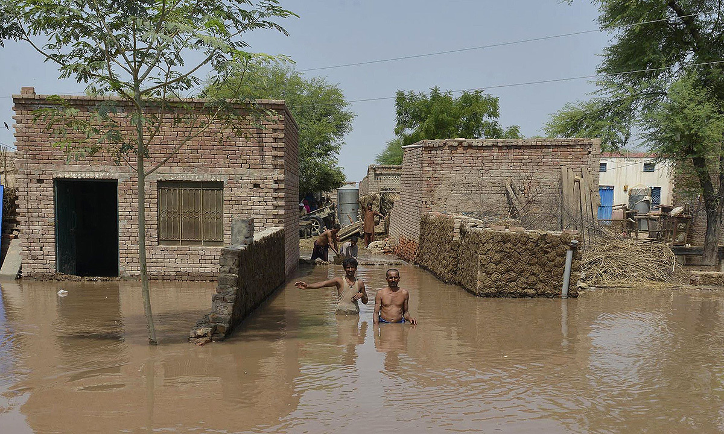

Slide 31
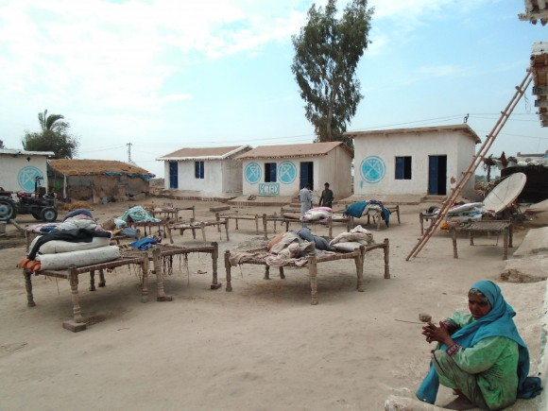

Slide 32
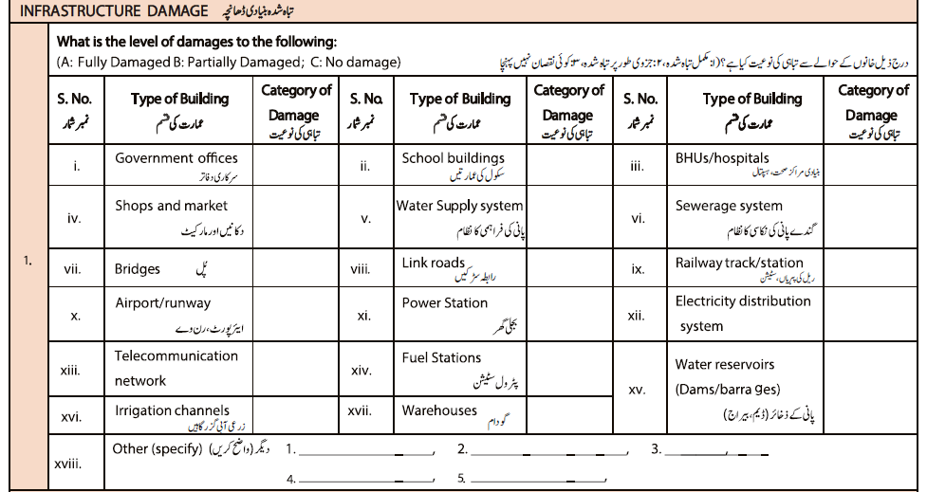
Data Collection- Direct Observation
Two types
Structured (Check list)
Looking for a specific behaviour e.g. soap use, hygiene condition, state of latrines etc.
Unstructured
Looking at how things are done and what issues exist

Slide 33
PRIMARY DATA COLLECTION TOOLS
Group 1
Key informant
Group 2
Key informant
Group 3
Direct Observation
Direct Observation Checklist
Group 4
Direct Observation

Slide 34
Do’s and Don’ts of Interview Techniques
PRIMARY DATA COLLECTION TOOLS

Slide 35
Interview Do’s
Pay attention in the choice of the key informant, balancing time available good choice of respondent, gender and diversity considerations
Establish contact first by introducing yourself, team and organization (wear official the tags, if available)
Describe the objectives of the interview/assessment, the expected length, the collection method (e.g. PDA)
Request informed consent for conducting interview
Notes:
The choice of KI is very important as it may determine the success of the interview and the quality of the data.
Normally KY will be chosen for the broad knowledge of the situation in the area and for being presumed able to answer accurately all the MIRA questions.
In principle, this will not exclude women, especially if holding certain functions within a village (teacher, social workers, doctors, administrators etc.) that may put them in a position to have a good overview on the situation to be well able to respond to ALL questions of the MIRA.
However, if this turns out a very difficult task or requiring too much proactive research and therefore time, and as the LAST RESORT, the enumerator can privilege men for the complete answers of the whole MIRA questionnaire but definitely try to reach out to a significant number of women in order to answer the female MIRA questionnaire.
Introduction explaining the identity of the informant, the type of exercise, the purposes helps to establish confidence and trust but also provides CLARITY TO MANAGE EXPECTATIONS
If data are collected with a PDA, explain what it is and how it works, as most likely the respondents will ignore
Request consent (ref. earlier slides)

Slide 36
Interview Do’s
Hold the interview in a place that put the respondent(s) at ease
Respect the local customs, behaviors and beliefs.
Show empathy and friendly behavior, establish rapport and inspire confidence and trust
Speak clearly and repeat the question if necessary
Avoid using humanitarian acronyms', always spell the names or the concept (including MIRA)
Listen carefully, record data properly
Do not presume, do not assume the meaning of an answer, ask politely to repeat
Notes:
Selecting a proper place, including by asking the KI, may also be a key to a good success of the data collection
Respect for local custom will be relevant especially for women. Normally a female enumerator will likely approach a female KI, but if for the purpose of the exercise it may be requested that men approach women, the consent needs to be asked
Explaining the questions clearly may avoid the necessity to repeat. If there is a sign of lack of clarity, the respondent should be asked whether she/ he would like the question to be explained again.
If the interlocutor is unclear, do not try to make up for the answer, ask politely again (“did I understand correctly that you said....? Can you please repeat again just to make sure that I understand?)
In order to make sure that all questions are properly and consistently explained and covered BRING ALWAYS A COPY OF THE DEFINITIONS WITH YOU

Slide 37
Interview Do’s
Pace yourself according to the time allotted for the interview
Note down your own observations about the process and content of the interview if you feel necessary
Go through all questions, check before the end
If key protection risks are expressed, refer them confidentially to Protection colleagues for appropriate and confidential follow up.
Thank the participant for making his or her time available
Notes:
Do not show lack of respect by cutting your interlocutor, but reminding him/ her that there are other locations to be visited ad therefore the time allocated for the interview is necessarily limited and need to remain within a certain limit.
Every enumerator will have his/ her own way to collect additional information, or take notes on important things. The enumerator shall always be equipped with paper
Although all the interviews will be on PDAs, it may be useful to always have a paper form at hand
In order to make sure tat all questions are properly and consistently explained and covered BRING ALWAYS A COPY OF THE DEFINITIONS WITH YOU

Slide 38
Interview Don'ts
Don’t use judgmental tones that may influence responses
Don’t show non-serious attitude, maintain a professional tone
Don’t read immediately all the possible answers of the multi-response questions, let the respondent talk and note
Don’t try to influence the responses in any way
Avoid arguing with the respondent
Let the respondent articulate his/her response
Notes:
I the limits of time and practicality, a good variety of KI is important. Do not assume that certain categories of persons will NOT be able to answer.
Respect, politeness and empathy does not mean to identify oneself with the KI. A professional attitude needs to be maintained.
For multiple questions, it will be important not to pre-empt the question by reading immediately all possibilities, but rather let the respondent guide the question and note/ track accordingly.
While conscious of the time, do not cut systematically the respondent before the end of the questions

Slide 39
Interview don'ts
Don’t get stuck on a question
Do not argue with a team member about a question or questioning method
If the KI is uncomfortable with the questions, do not insist they answer
Don’t create expectations about future humanitarian support and promises you cannot keep
Don’t prevent respondents from asking you questions at the end of the interview
Notes:
Although it is important for statistical purpose that all questions are answered, if it is really impossible to have an answer on a questions (of the respondents prefers not to respond) the enumerator needs to face the fact and renounce to that question.
Team members should always be respectful of each other in the presence of community as well as being respectful with all stakeholders, but particularly not to raise a difference of opinion while questions are being asked. If you have any reservation on the way a question was posed please do so after the interview is over and in private. You may share this with team leader if the conflict of opinion persists.
Managing expectations is critical and shall be done immediately at the beginning of the questionnaire, but it may also be reminded at the end as a conclusive remark
As the respondent has devoted time to you, you can ask whether he/she has questions for you at the end, politely highlighting that the time is limited and that there will be not much time for conversation, as other areas need to be visited, but at the same time showing respect for the interlocutor/ KI.

Slide 40
MIRA in action

Slide 41
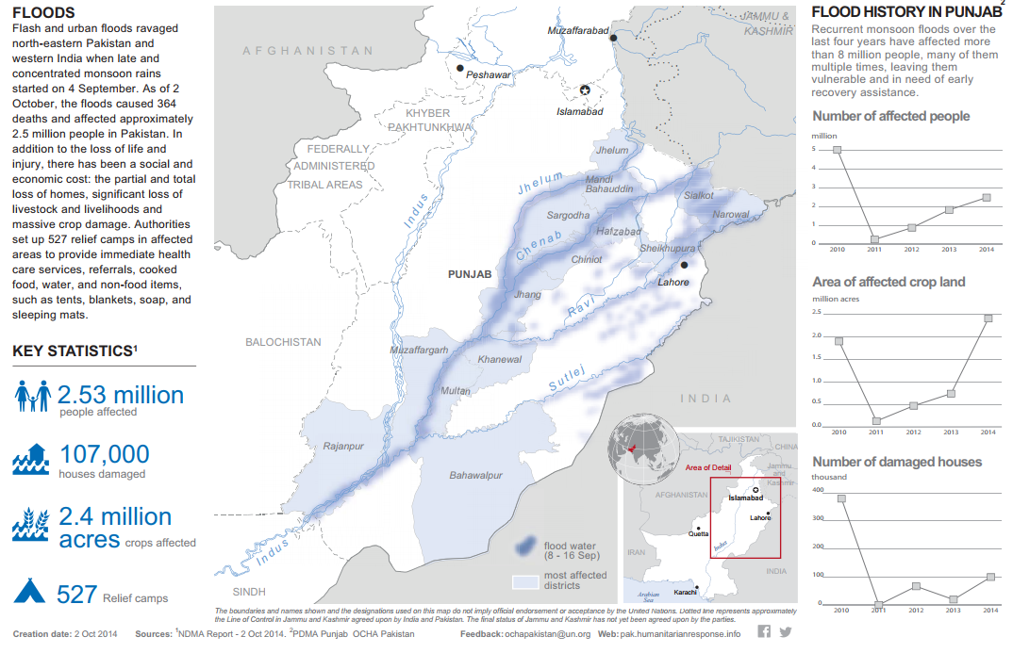
MIRA in action
41

Slide 42
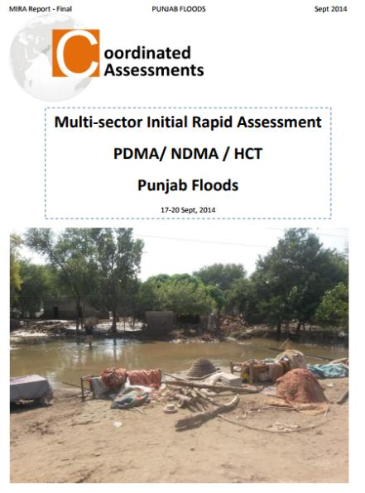
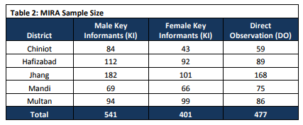
MIRA 2014
541 villages assessed through key informant interviews (random sample)
63 enumeration teams, more than 50% had a female enumerator

Slide 43
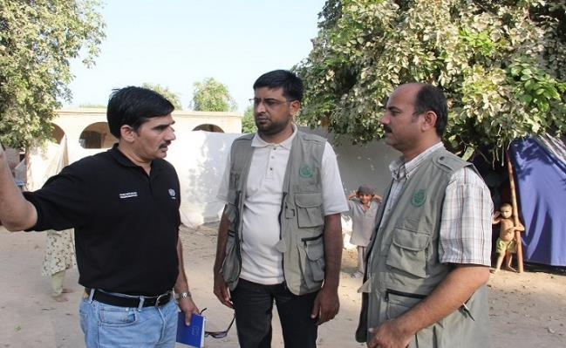
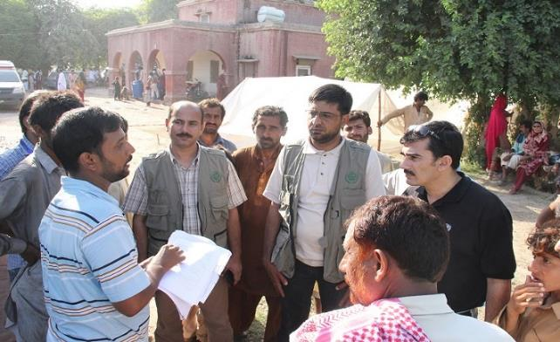
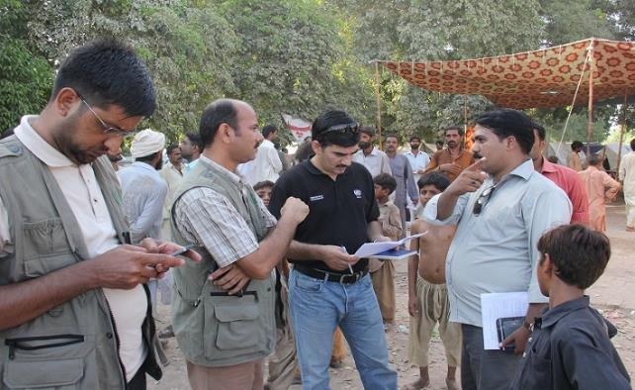
Primary data collection

Slide 44
Highlights
Although a large area of Punjab was impacted by the floods, in many areas the water has receded significantly
77% of the crops were damaged due to floods in the affected areas of the five districts
73 relief camps reported as operational, with some 52,000 people continuing to access services provided there
Households in affected areas across the districts lost on average 42% of their food stocks
20% of houses are partially damaged and 16% of houses are fully damaged
13% of the total assessed population were without shelter at the time of the assessment, while 4% were living in makeshift shelters, 8% in tents and 1.8% in communal buildings (such as schools, hospitals and government buildings
1.8 million
persons affected in Punjab
2.413 million
acres of cropped area has been affected

Slide 45
ODK Collect
Only android phones
Go to play store
Install ODK Collect
Connect to MIRA to server
Download MIRA questionnaire
Fill and submit

Slide 46
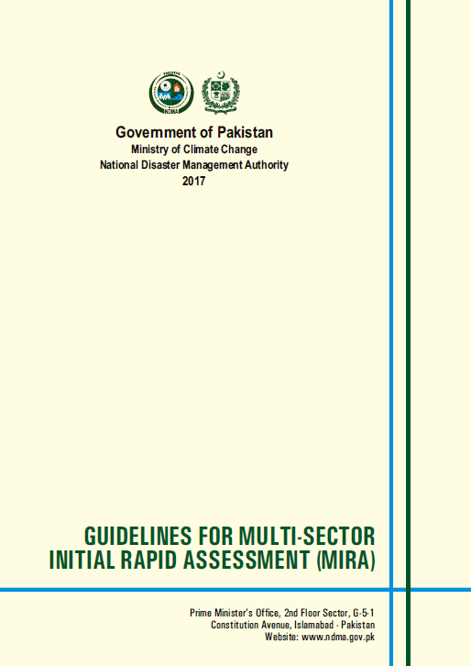
Course Materials
46
Guidelines are available on
www.ndma.gov.pk/publications/MIRA GUIDELINES.pdf
Notes:
Please refer to MIRA Guidelines during the sessions

