Slide 1



Module 1 Awareness
Safeguarding Focal Point Training

Slide 2
Learning Outcomes
SFPs will be able to:
Recognize potential indicators of safeguarding violations, including different types of harm, and local safeguarding priorities
Understand how safeguarding work is framed in their organization(s), and the location/content of relevant policies
Understand their role in organizational safeguarding and how to support associated workplans in their country offices/programs

Slide 3
Session 0: Introduction

Slide 4
Ground Rules
Ensure you have your preferred name showing
Please mute yourself while others are speaking
Please keep your video on unless you have connection issues
Please use the chat box / or raise hand when you have questions
Only step away from training during assigned breaks
Please participate as much as possible

Slide 5
Rank in order of most to least powerful
  5-year-old boy
  30-year-old female Head of Office
  43-year-old male livelihoods officer
  22-year-old female head of household
  13-year-old schoolgirl
  70-year-old man who is blind

Slide 6
Session 1: Recognizing Harm

Slide 7
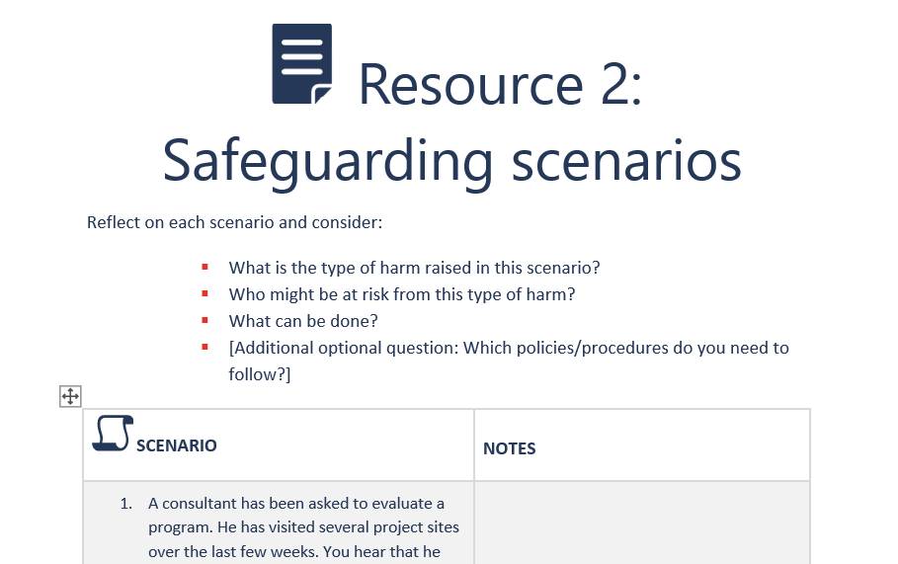
Safeguarding Scenarios
What is the type of harm raised in this scenario?
Who might be at risk from this type of harm?
What can be done?
[Additional optional question: Which policies/procedures do you need to follow?]

Slide 8
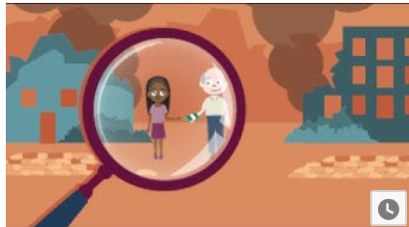

Optional: Video
Option 1: What if it were you?
Option 2: Child safeguarding in emergencies
Notes:
IASC video, What If It Were You (useful when discussing these issues from a bystander perspective)
https://interagencystandingcommittee.org/iasc-learning-package-protection-sexual-misconduct-un-partner-organizations
Save the Children video, Child safeguarding in emergencies (explains safeguarding in relation to children; available in several languages)
https://youtu.be/GQhOuq7BFLY

Slide 9
Conclusions
There are different types of harm that exist in humanitarian and development contexts.
Some kinds of abuse and exploitation are a result of cultural practices in communities that are harmful, but others arise out of the actions or inactions of staff or organizations.
A key responsibility is to prevent harm to those we work with. The organization should have policies and procedures to respond to and manage safeguarding concerns.

Slide 10
Session 2: Contextualizing Safeguarding

Slide 11
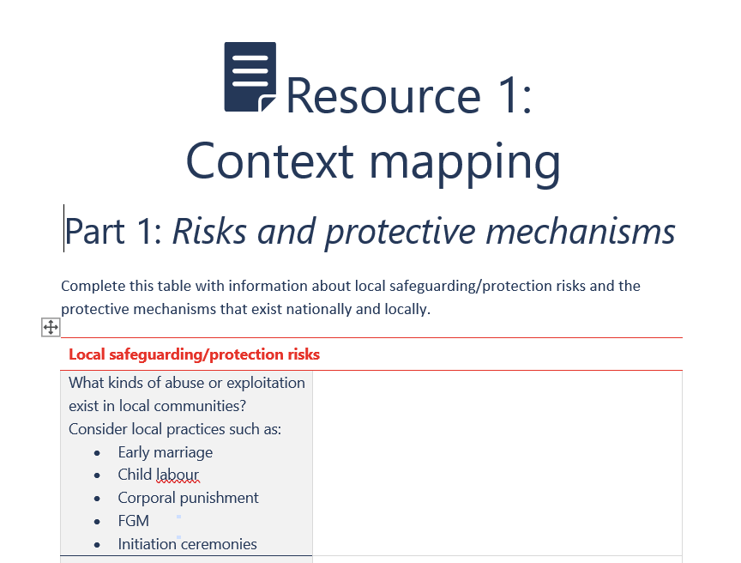
Review of Context Mapping
  Part 1: Risks and Protective Mechanisms
    Identify the most important point from each section (e.g. the section on what kinds of abuse exist in local communities) you would like to share with the group.
  Part 2: Policy Summary
    Identify one policy that exists within your organization that covers an element of safeguarding you would like to share with the group.

Slide 12
Conclusions
Safeguarding priorities will differ between and within countries, so it is important for SFPs to understand the context in which they are working.
Organizations need to have policies and procedures in place to respond to and manage safeguarding concerns in a consistent way.
Different organizations may address different elements of safeguarding in different policies.
Focal points should know the location and content of the various policies, as well as the content owner responsible for updating those policies.

Slide 13
Session 3: Roles and Responsibilities
SFP Training

Slide 14
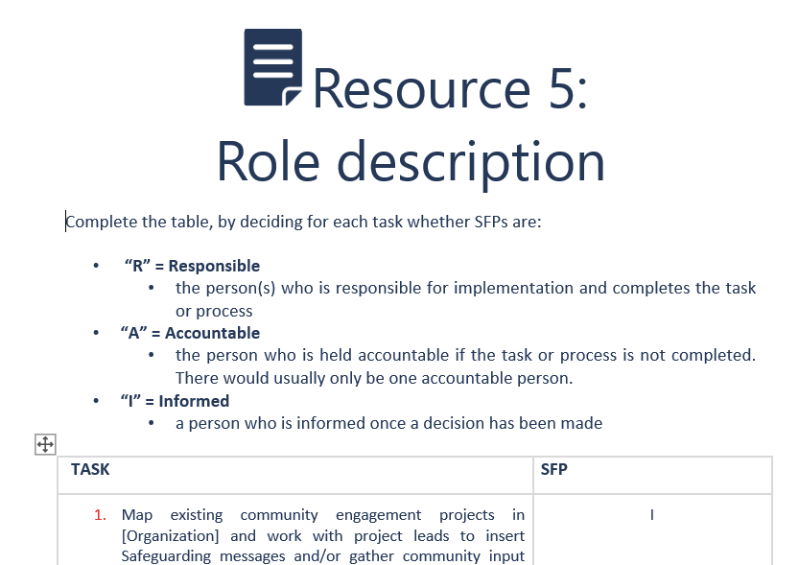
Roles and Responsibilities
For each task, decide if that role/function is:
R | Responsible | the person(s) responsible for implementation and completes the task or process
A | Accountable | the person held accountable if the task or process is not completed; there would usually only be one accountable person
I | Informed | the person informed once a decision has been made

Slide 15
Conclusions
All staff have a role and responsibility in safeguarding, but there are certain responsibilities that lie with SFPs.
The Focal Point designation is a role or “hat” assigned to existing personnel and not a full-time position, so it is important to respect the need to balance the SFP’s regular job with meaningful engagement on Safeguarding.
SFPs are typically chosen because of their personal as well as professional attributes – they are trusted individuals who are known to demonstrate care and compassion.
The nomination of an SFP does not relieve the Head of Office as ultimately responsible for Safeguarding in his/her office but supports the Head of Office to fulfill that responsibility.

Slide 16
Session 4: Additional Sessions

Slide 17
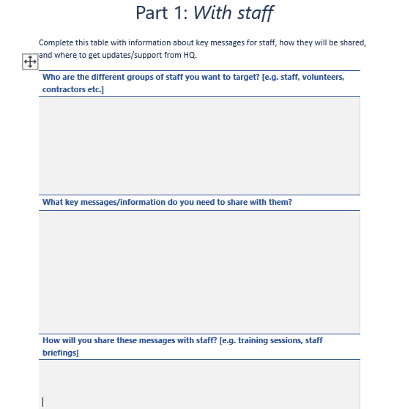
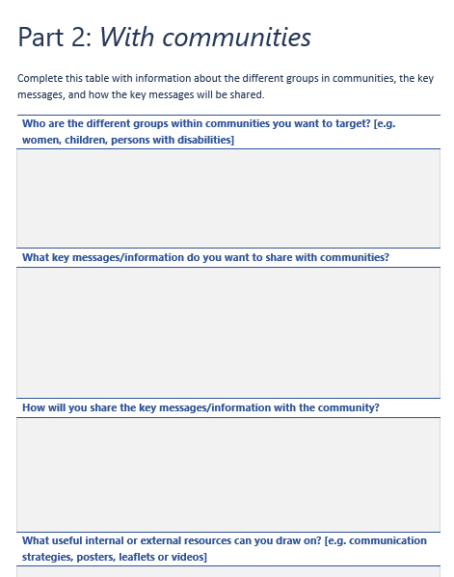
Online Assignment | Option 1 Key Messages
Group 1:
  Who are the different groups of staff you want to target (e.g. staff, volunteers, contractors)?
  What key messages/information do you need to share? [brief summary]
  How will you share these key messages with staff?
  Additional: what useful internal or external resources can you draw on?
Group 2:
  Who are the different groups within communities you want to target (e.g. women, children, persons with disabilities)?
  What key messages/information do you need to share? [brief summary]
  How will you share the key messages with the community?
  Additional: what useful internal or external resources can you draw on?

Slide 18
Wrap-up
  There are different types of harm that can arise in our work due to imbalances of power between organizations, staff, and communities where we work.
  Safeguarding is underpinned by international standards, should adhere to local laws, and should address the risks that are prevalent in that context.
  Organizations may have various policies relating to different aspects of safeguarding that are central to guiding the work of SFPs.
  Focal points play a key role through supporting the development and implementation of safeguarding work plans in their country office(s)/program(s).
SFP Training

