Slide 1



Module 2 Prevention
Safeguarding Focal Point Training

Slide 2
Learning Objectives
SFPs will be able to:
Understand what information to disseminate among staff including through staff training
Understand how to develop relevant safeguarding messages for communities
Support safeguarding assessments
Liaise effectively with other SFPs to contribute to collective PSEA measures, and coordinate with other actors to ensure appropriate referral pathways

Slide 3
Session 0: Refresher

Slide 4
Ground Rules
Ensure you have your preferred name showing
Please mute while others are speaking
Please keep your video on unless you have connection issues
Please use the chat box / or raise hand
Only step away from your computer during assigned breaks
Please participate as much as possible

Slide 5
Session 1: Raising Awareness

Slide 6
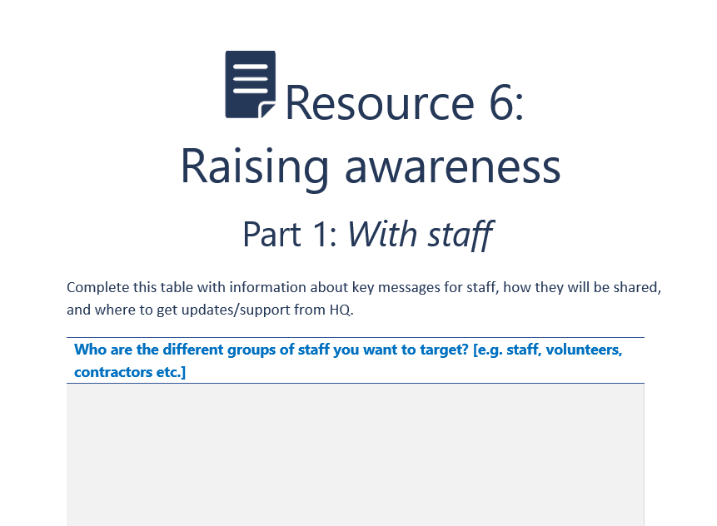
Raising Awareness with Staff and Communities
Who are the different groups [staff/communities] you want to target?
What information do you need to share?
How will you share the information?
[Additional: what internal or external resources can you draw on? For example, training materials, communication strategies, or any technical advisor, etc.]

Slide 7
Key Messages
We all have responsibility for safeguarding and to promote a positive safeguarding culture
Zero tolerance for harm and abuse
Duty to report - Speak Up!
Inaction is not an option
Maintain confidentiality at all times
Report suspicious, actual, historic, and anonymous safeguarding concerns immediately
We all have a duty of care to one another – to every child, woman, and man that we are there to serve and support in the community, and to our work colleagues, to act in their best interests to ensure their safety and to act to eliminate or minimize any risk of harm

Slide 8
Useful Resources
IASC 6 principles
No Excuse for Abuse film
Say No to Misconduct film
Organizational code of conduct translated into local language(s)
Resource 7: Template training agenda [or other alternative from the organization]

Slide 9
Conclusions
SFPs play a key role in raising awareness on safeguarding and should work with Heads of Office and other key staff to develop, strengthen, and implement strategies for raising awareness with staff and communities
Communication strategies should consider who they are targeting, what information needs to be shared, and how they will share it
There are many resources that SFPs can draw on, including safeguarding advisors, training resources, and communication materials. It is important for SFPs to link with safeguarding staff at headquarters to ensure information and updates are quickly disseminated.

Slide 10
Session 2: Safeguarding Assessments

Slide 11
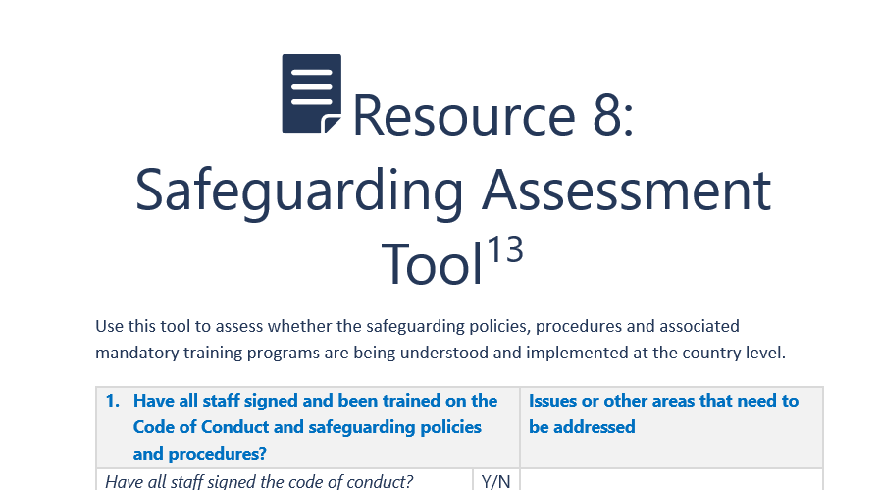
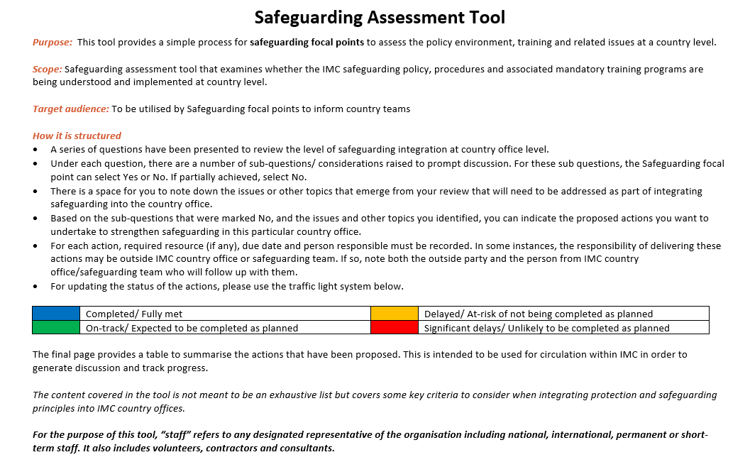

Slide 12
Conclusions
SFPs may be involved in conducting safeguarding assessments at the country office level, which can assess the policy environment, training, and related issues. This can help inform country teams and their safeguarding workplans.
It is important to regularly review the findings of this assessment to identify any new issues and to update mitigation strategies.

Slide 13
Session 3: Working with Safeguarding Networks

Slide 14
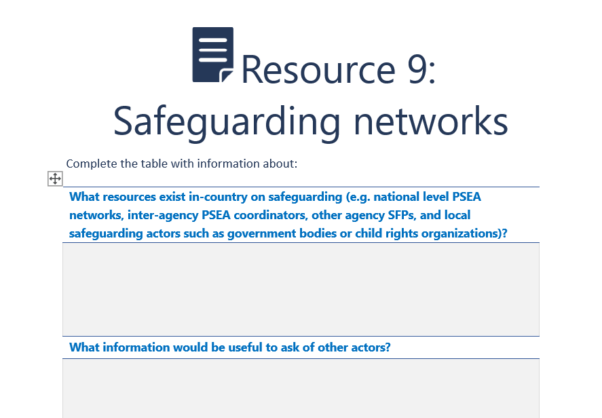
Safeguarding Networks
What resources exist in-country on safeguarding (e.g. national level safeguarding/PSEA networks, inter-agency PSEA coordinators, other agency SFPs, and local safeguarding actors such as government bodies or child rights organizations)?
What information would be useful to ask other actors?
Who is best placed to provide information on any referral mechanisms in place?
What information can you share when talking about safeguarding in your organization with external actors? Is there anything you cannot share?

Slide 15
Conclusions
In-country safeguarding networks can provide valuable information and support to SFPs on safeguarding.
It is important to understand what information can be shared with others, and what should not be shared, as well as what information is useful to gain from other actors.
Ensure sufficient time is allocated to identifying and networking with relevant safeguarding focal points and networks.

Slide 16
Session 4: Additional Sessions

Slide 17
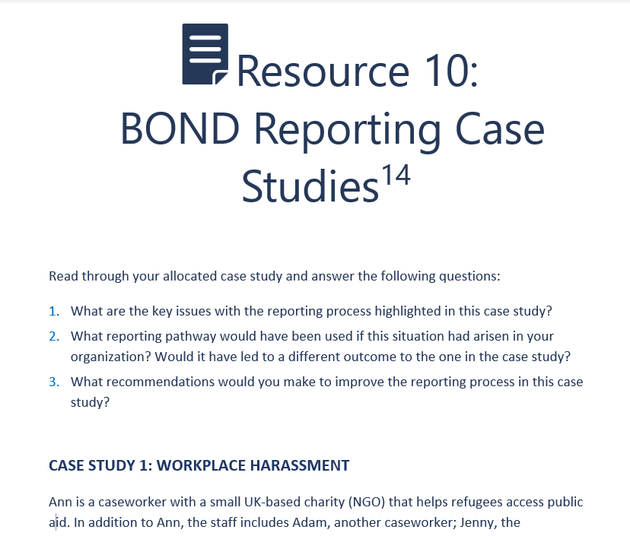
Online Assignment |BOND Reporting Case Studies
What are the key issues with the reporting process highlighted in this case study?
What reporting pathway would have been used if this situation had arisen in your organization? Would it have led to a different outcome than the one in the case study?
What recommendations would you make to improve the reporting process in this case study?

Slide 18
Wrap-up
  SFPs play a critical role in raising awareness of safeguarding with staff and may also support programs to do this with communities.
  SFPs may be involved in conducting safeguarding assessments at the country office level, which can help inform country teams and their safeguarding workplans.
  SFPs should liaise with Safeguarding Focal Points from other NGOs and UN agencies in-country, and PSEA/Safeguarding networks where established.
  It is important for country offices to be aware of and, where appropriate, contribute to collective, inter-agency measures to prevent and address PSEA/Safeguarding violations.

