Slide 1



Module 3 Reporting
Safeguarding Focal Point Training

Slide 2
Learning Objectives
SFPs will:
Understand the concept and implementation of community-based feedback mechanisms and response mechanisms.
Understand how to receive safeguarding complaints at field level and channel complaints to the appropriate reporting mechanism.
Be aware of how to document and report barriers to reporting and seek advice/escalate concerns when required.
Be aware of data protection issues and guidelines including asking for consent and how to share and manage information.

Slide 3
Session 0: Refresher

Slide 4
Ground Rules
Ensure you have your preferred name showing.
Please mute when others are speaking.
Please keep your video on unless you have connection issues.
Please use the chat box / or raise hand when you have questions.
Only step away from your computer during assigned breaks.
Please participate as much as possible!

Slide 5
Session 1: Community-Based Feedback and Response Mechanisms

Slide 6





Making Sure that the Mechanisms Work in the Context
2. Channels
    Suggestion box
    WhatsApp group
    Hotline
    Home visit by female staff
    3. Complaints
    The content of the distribution was not what you needed.
    The staff on the project are rude; they always stare when they visit.
    The wrong people are on the list of program participants.
    You heard that some women receive additional food rations because they are close friends with the distribution officer.
1. Characters

Slide 7
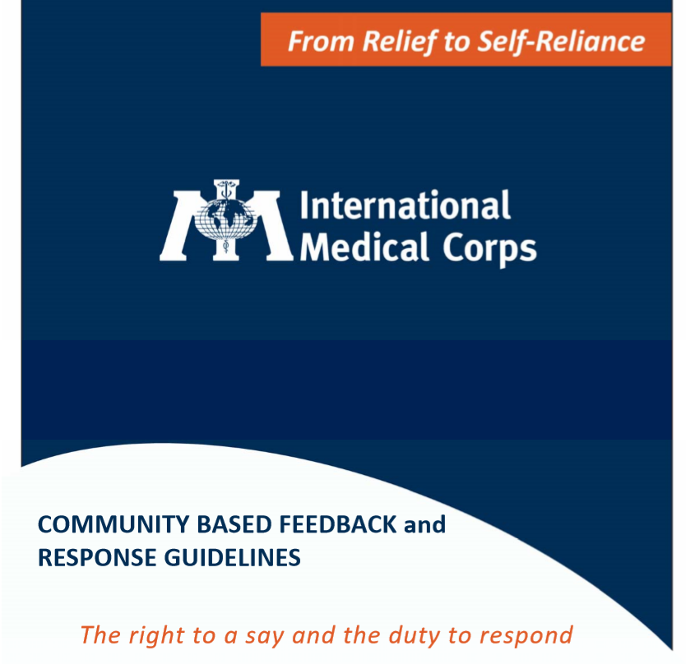

Slide 8
Key Messages
Every agency will have own approach to community-based feedback and response mechanisms, depending on their mode of operating, the context, resources, and policies.
However, certain principles should apply to ensure that they are inclusive, empowering, and do no harm to users wanting to share concerns, particularly those relating to safeguarding.
There should be multiple, accessible, safe, and confidential channels, chosen on the basis of consultations with communities.

Slide 9
Session 2: Reporting Safeguarding Concerns

Slide 10
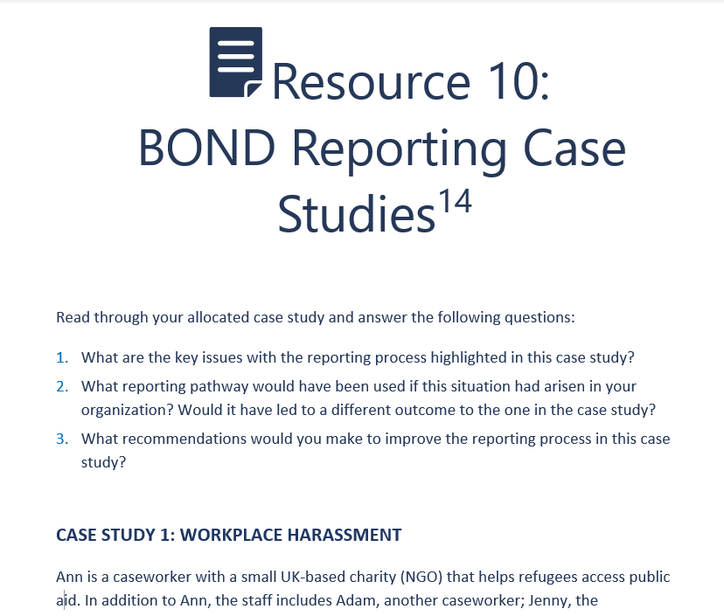
Online Assignment |BOND Reporting Case Studies
What is a key recommendation that emerged from these case studies?

Slide 11
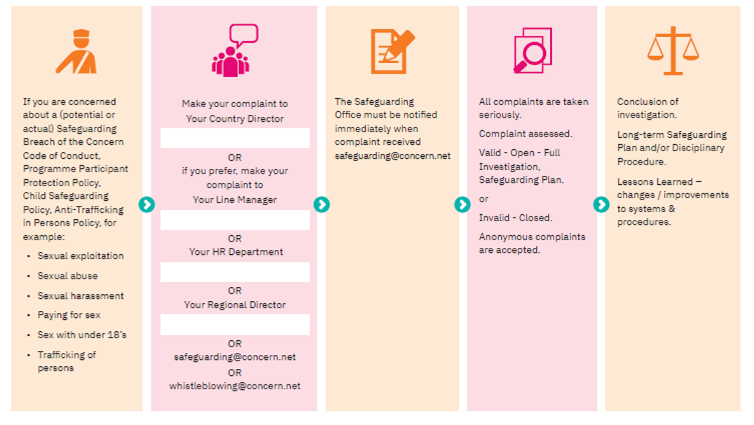
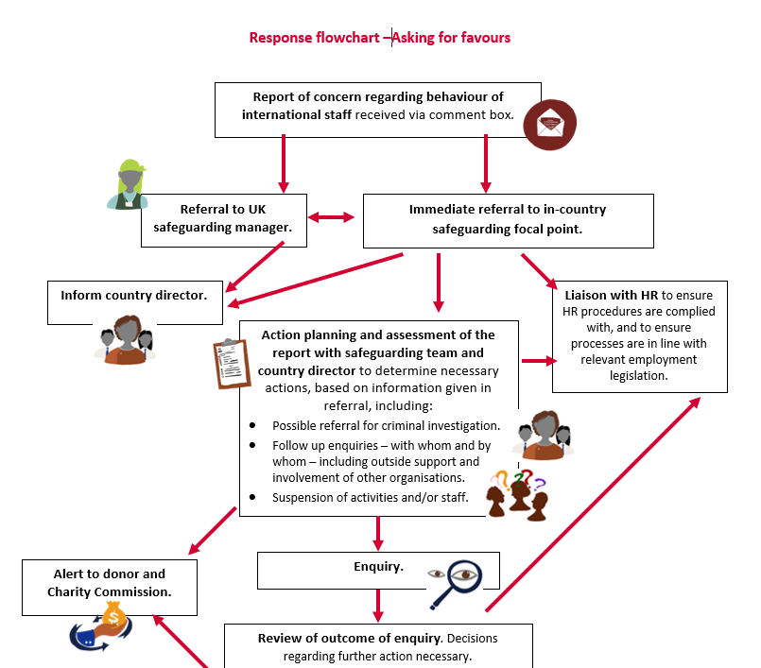

Slide 12
Key Messages
Responding to feedback and complaints can be complex and raise many difficult dilemmas.
Well-functioning and appropriate report-handling mechanisms can help organizations address some of these safeguarding challenges.
At a minimum, SFPs should be aware of the systems and procedures in place in their organization to manage sensitive cases in a safe, confidential, and transparent way. They should also know and how and where to escalate complaints.
SFPs have an important role to play in ensuring staff, program participants, and their communities are aware of the available reporting channels.

Slide 13
Session 3: Barriers to Reporting

Slide 14
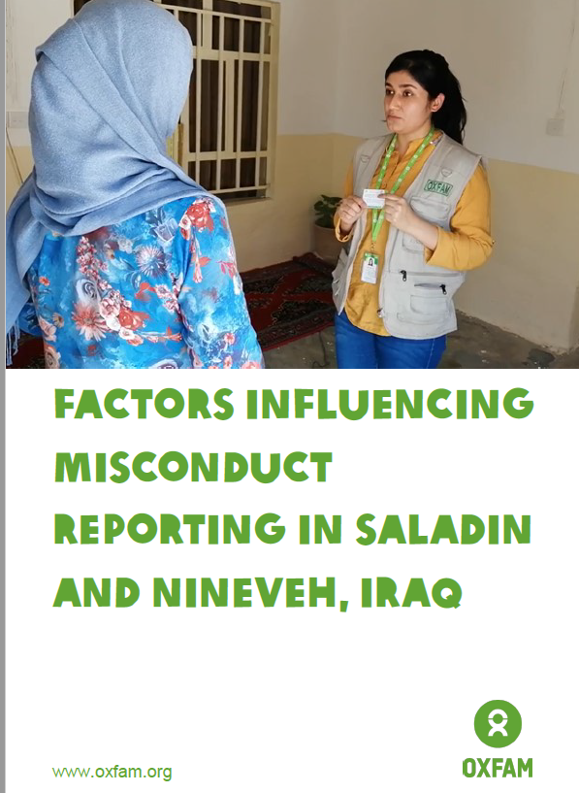
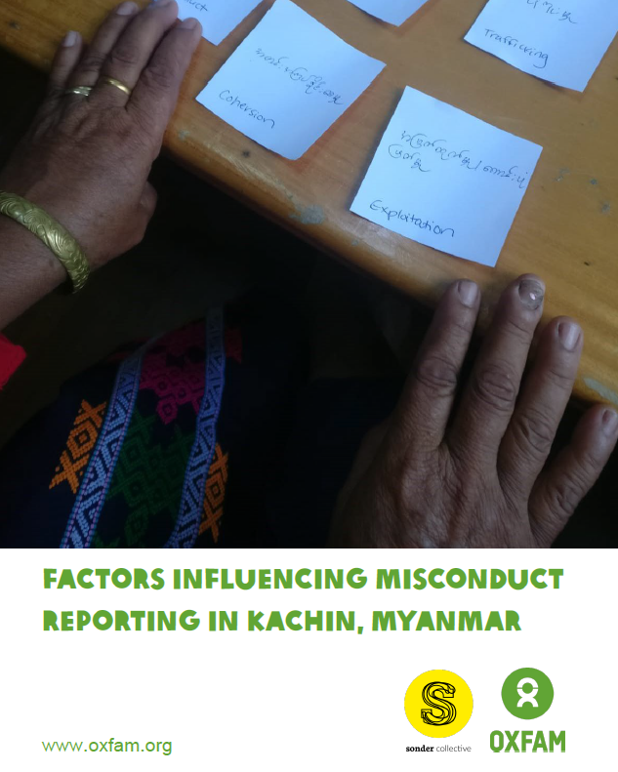
Resources

Slide 15
Key Messages
There may be varied reasons why staff, communities, and program participants do not report safeguarding concerns.
It is important to monitor and analyze barriers to reporting ranging from any physical or logistical barriers to cultural barriers. Mitigating actions should be identified.
Multiple channels are needed to enable reports of safeguarding concerns, but informal channels, including monitoring visits, can also provide important opportunities for people to raise concerns.
Many barriers to reporting can be linked back to poor design processes (lack of consultation with communities about their preferences for sharing concerns) and lack of information (for example about the organization, programs, expected behaviors, and ways to report concerns).

Slide 16
Session 4: Additional Sessions

Slide 17
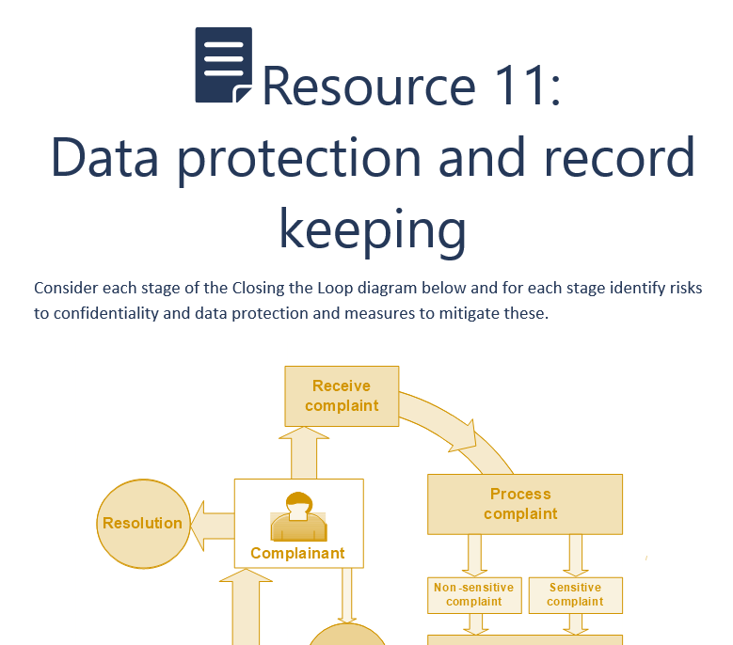
Online Assignment |Data Protection and Record Keeping

Slide 18
Wrap-up
Every organization should have a feedback and response mechanism in place to receive safeguarding concerns.
It may be difficult for people to raise concerns. Mechanisms should be context-specific and designed and implemented in collaboration with communities. Barriers to reporting should be analyzed and mitigation strategies considered.
At a minimum, SFPs should be aware of the systems and procedures in place in their organization to manage sensitive cases in a safe, confidential, and transparent way and how/where to escalate complaints.

