Slide 1



Module 4 Responding
Safeguarding Focal Point Training

Slide 2
Learning Objectives
Understand and be able to apply the principles of person-centered approach, including confidentiality, consent, and how to share information safely.
Understand how to address immediate safety concerns, including providing information.
Understand the process of investigations and the duty to report concerns and maintain confidentiality.

Slide 3
Session 0: Refresher

Slide 4
Ground Rules
Ensure you have your preferred name showing.
Please mute yourself while others are speaking.
Please keep your video on unless you have connection issues.
Please use the chat box / or raise hand when you have questions.
Only step away from your computer during assigned breaks.
Please participate as much as possible!
This session may raise sensitive issues. Please be aware that there is an employee assistance program available.
Ensure no detailed information about safeguarding experiences are shared.

Slide 5
Session 1: Person-Centered Approach

Slide 6
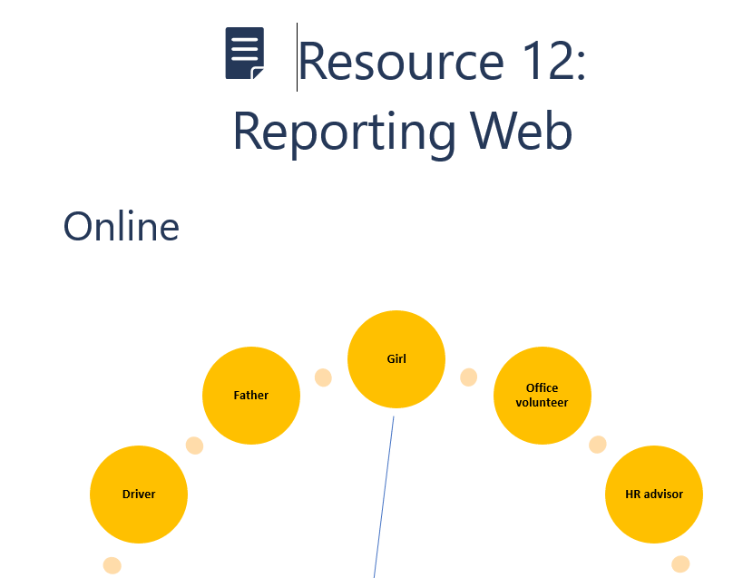
Reporting Web
Every time a new character becomes involved in the girl’s story, draw an arrow to that character

Slide 7
Person-Centered Approach
Safety and confidentiality
  Essential for promoting trust and empowerment and reducing the risk of further harm to those involved in the process.
  Any information should be shared on a strict “need to know” basis.
  The survivor and/or complainant should be informed about what information will be shared with whom.
Right to information
  Share information about potential next steps and how their information will be kept confidential (or when/with whom it might be shared).
  Be clear that in some situations, confidentiality may not be guaranteed.
Right to choose and be treated with respect, dignity, and non-discrimination
  All those involved in the process should be treated with dignity and respect, regardless of their age, gender, ethnicity, religion, or any other characteristic.
  Prioritize the preferences of the survivor where possible and safe.
  Where the person involved is a child, their best interest should be central to any decisions made.

Slide 8
Conclusions
A person-centered approach means ensuring every action and decision is made with the best interests of the person harmed at the center. It also means that the safety and well-being of other people involved are considered.
Reporting mechanisms should consider how sensitive complaints can be made and processed in a simple, safe, and confidential ways.
All steps in the process should be clearly outlined to survivors to ensure they can make an informed choice.

Slide 9
Session 2: Addressing Immediate Needs

Slide 10
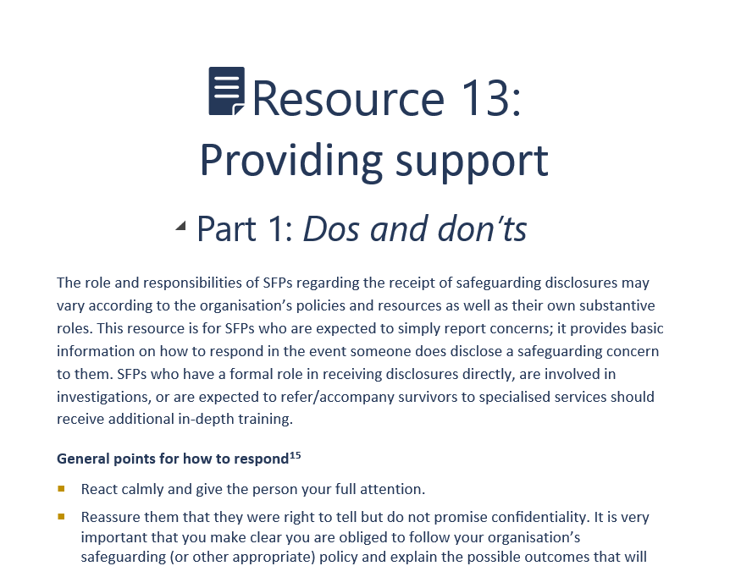
Do’s and Don’ts
Consider the scenario you have been assigned and answer:
What Do’s and Don’ts for responding to disclosures are highlighted in this scenario?
How could the person(s) receiving the disclosure have responded differently?

Slide 11
Common Reactions to Sexual Violence
In situations where the victim discloses sexual violence, be aware that no two people are the same, and reactions can vary considerably. in response to incidents of sexual violence, survivors commonly:
Feel numb, “cut off,” or in shock
Appear perfectly calm and unaffected
Fear they are “going mad”
Have intrusive memories (unexpected memories of the trauma)
Feel irritable or angry
Blame themselves
Engage in uncharacteristic behavior
Alter their eating habits
Feel the need to wash repeatedly
Vomit or have other physical symptoms

Slide 12
Recording Information
Use the organization’s standard reporting form to make sure you gather all the relevant and important information.
Any concerns, allegations, or disclosures should be written down as soon as possible.
Records should be signed and dated.
Records should be detailed and precise. They should focus on what you and the other person said, what you observed about the person (their demeanor and how they presented themselves), who was present, and what happened. Speculation and interpretation should be clearly distinguished from reporting.
Any concern, disclosure, or allegation is alleged rather than proven at this point.
All such records should be treated as conﬁdential. They should be passed only to the persons speciﬁed in the reporting pathway. It is the responsibility of each individual in possession of the information to maintain conﬁdentiality.

Slide 13
Mapping Services
In most instances, only specialized staff will be involved in referring or accompanying people to services for survivors of safeguarding incidents.
In the event you receive a disclosure directly from a survivor, they may show signs they need immediate referral, including if they are a survivor of sexual violence.
Survivors should be informed about available medical facilities and their rights and options and stress the importance of receiving prompt emergency care (ideally within a few hours but up to 24 hours; for example, PEP kits need to be administered within 72 hours after the incident).
Ask the survivor for permission before connecting them to any of these services - if s/he says no, you must respect this choice unless there is an immediate threat to their life, they are at risk of harming others or themselves, or they are unable to care for themselves or keep themselves safe.

Slide 14
Mapping Services
Service | Organization | Contact point | Opening hours
Medical services
Mental health and psychosocial support
Safe refuge
Legal services
Social services
Child protection services
Other

Slide 15

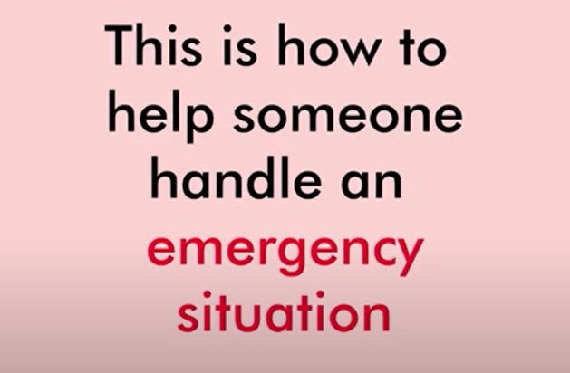
Optional: Video
Option 1: Responding to a GBV Disclosure
Option 2: Psychological First Aid

Slide 16
Conclusions
It is important for SFPs to know their role and responsibility with responding to disclosures, including the limits of their role.
If a safeguarding concern is disclosed, SFPs should ensure the immediate safety and well-being of the survivor.
It is important to make anyone disclosing feel safe and comfortable by actively listening to what they are saying, but SFPs should not investigate or ask for detailed information.
SFPs may provide information on services available and should have these regularly updated, in preparedness to respond.
When appropriate to do so, SFPs should use the organization’s reporting form to record any important information and pass this on to the relevant person according to the organization’s policies.

Slide 17
Session 3: Investigations

Slide 18
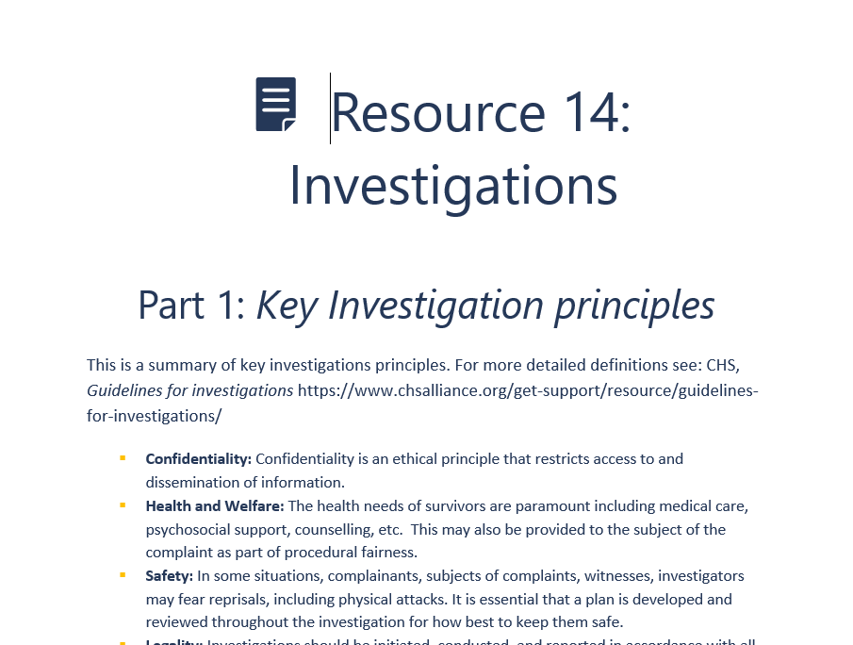
Investigations
Part 1:
  Which principle is the hardest to adhere to?
  Which principle is the most important to adhere to?

Slide 19
 | Key steps of an investigation
1 | Receive an allegation
2 | Make management decision on how to proceed
3 | Appoint investigation team
4 | Plan the investigation and undertake a risk assessment
5 | Gather and study background material and documentary evidence
6 | Update investigations plan and draft interview questions
7 | Interview witnesses
8 | Write investigation report and management outcome report
9 | Conclude the investigation, and submit report to management for appropriate follow-up

Slide 20
Session 4: Additional Sessions

Slide 21
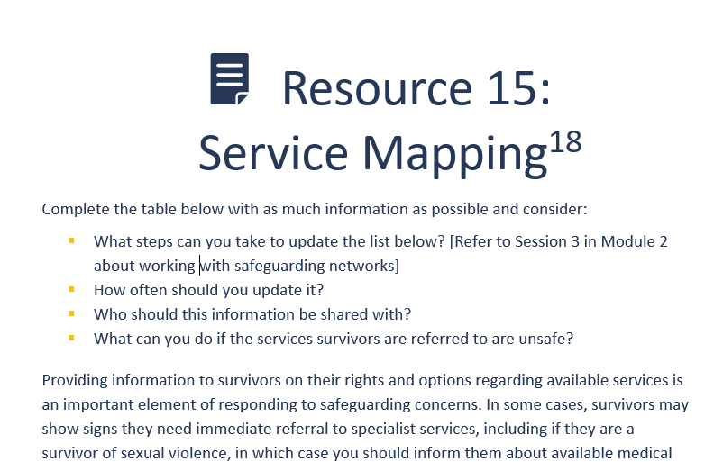
Service Mapping
What steps can you take to update the list of services?
How often should you update it?
Who should this information be shared with?
What can you do if the services survivors are referred to are unsafe?

Slide 22

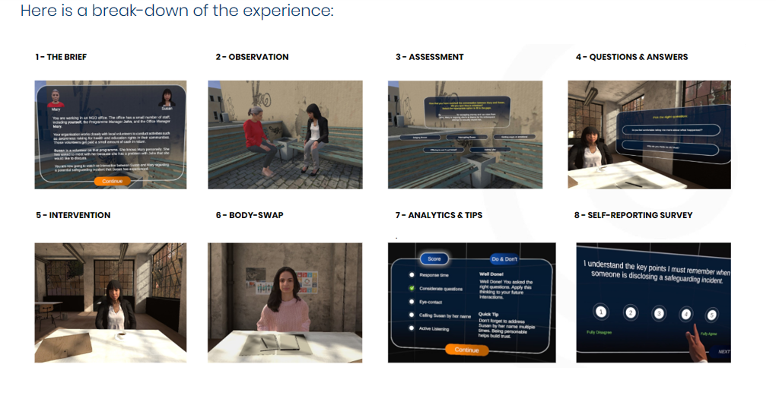
Safeguarding Virtual Reality
https://www.humanitarianleadershipacademy.org/safeguarding-vr-case-study/

Slide 23
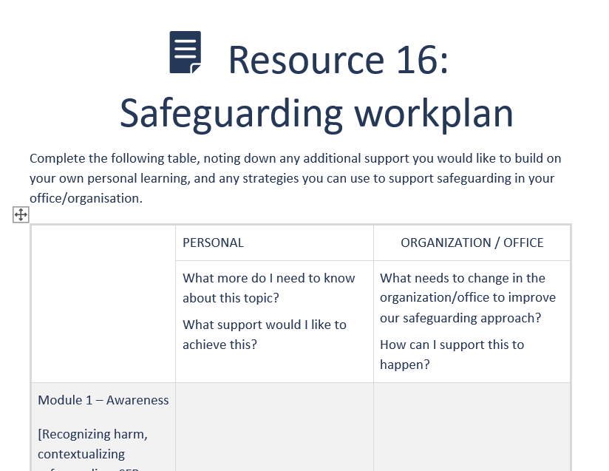
Safeguarding Workplan

Slide 24
Wrap-up
If SFPs receive a disclosure of a sensitive nature, they should immediately report the concern through the organization’s reporting process and maintain confidentiality.
The immediate safety and well-being concerns of the person affected should be prioritized. SFPs may also provide information on relevant services.
SFPs should understand the process and principles of investigations but are not expected to participate in investigations unless they have specific investigations training and have been requested to do so by the investigations team.

