Slide 1
Partner NNGO Capacity Strengthening Basics in Procurement and Goods, Services and Works Receiving
March 2023
Prepared by: Marin Tomas, Senior Advisor, Logistics and Supply Chain Management
International Medical Corps
E-mail: mtomas@InternationalMedicalCorps.org
This material is made possible by the generous support of the American people through the United States Agency for International Development (USAID). The contents are the responsibility of International Medical Corps and Concern Worldwide and do not necessarily reflect the views of USAID or the United States Government.

Slide 2
Key accountability areas for Organizations
Funds (irrespective of the funding source)
Through effective budgets management, ethical and transparent procurement and activities implementation,
Material Resources
Include management of equipment (assets) and supplies (stock) irrespective if source is procurement or donation.
Human Resources
Staffing must be appropriate, qualified and trained to effectively manage and implement project or function related activities.
Project implementation
Must be efficient and geared towards achieving set objectives within budget and timelines agreed with funding source and measured through defined indicators.

Slide 3
Primary accountability areas for Logistics
Procurement:
Correct quantification and specifications appropriate for activities implementation,
Understanding sourcing market/s,
Having pool of eligible, well performing vendors for each category of items,
Appropriate procurement procedure and approval process in place, proportional to cummulative procurement value,
Compliant with respective donor, organization and government procedures (as applicable),
Quality Assurance and Quality and Quantity Control of purchased goods, works and services.
Storage/Commodities Management
Accountability for quantity and quality of stored goods by item and project,
Documented transactions into, from or within warehouses, including damages, losses and disposals including daily stock report updates available to stock owners/project managers.
Assets Management
Transparent and accountable asset management with defined user for each asset and related up-to-date asset list/report.
Fleet Management (vehicles and generators)
Responsible and optimized vehicles, generators and fuel management.

Slide 4
I. How to get Goods and Services?
Goods and services required for project can be secured (obtained) through one of the following methods:
A. through Procurement
B. through Gift in Kind (Donation)
through Internal Transfer from another warehouse or office of the organization.

Slide 5
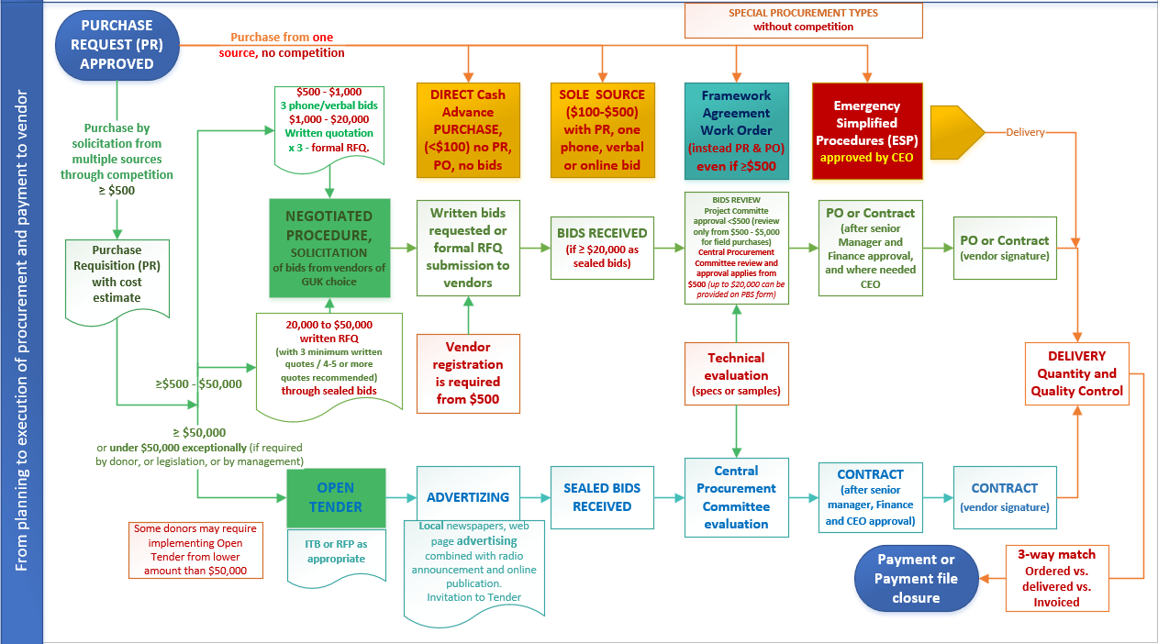
Procurement Process map

Slide 6
Procurement planning
Key for sucessful procurement action is joined procurement planning that involves program, technical staff, finance and logistics staff:
identified needs (supplies, services and equipment), estimate correct delivery timeline and costing based on source market assessment,
correct budget allocation projected,
timely procurement process initiation upon award of the project to ensure timely deliveries,
appropriate procurement procedure selection consistently.
These are contributing factors to achieve the Best Value for Money procurement - a key ask by funding sources!
We are expected to make decision any prudent businessman would make for own company, spending own money.

Slide 7
A. The procurement process
Procedure depends on the expected procurement value:
a. < $100 (direct purchase - Sole Source procedure)
b. $100 - $500 (one phone/verbal bid - Sole Source procedure)
c. 500 - $20,000 (negotiated procedure, min 3 bid from vendors of organization choice, written, formal RFQ – if applying competition under $1,000 phone/verbal bids are sufficient)
d. $20,000 - $50,000 min 3 bids required (4-5 bids preferred), must be sealed bids through negotiated procedure, formal RFQ, Procurement/Tender Committee analyze bids)
e. $50,000 or more (Public, Open Tender with sealed bidding)
Irrespective of USD value threshold Quality and Quantity of items received must be inspected at the time of handover from Vendor.
Special consideration in procurement:
Framework Agreement with fixed item prices for recurring purchases of frequently used goods and/or services.
Emergency response Simplified Procedures

Slide 8
a. Procurement < $100
Requestor fills out a Purchase Requisition (PR) form and asks procurement staff to enter cost estimates + Requestor gets signatures from authorized staff (Finance and Budget Holder/Project Manager). Assigned Procurement staff or field Procurement Committee makes direct purchase without bid, as amount is less than $100.
Quality and Quantity Control:
Goods are received to stock with a Goods Received Note (GRN) or by the dated stamp “Received” on Invoice signed by recipient (if received outside warehouse).
Goods are taken into stock and registered.
Services are received with stamp “Received”.
NOTE:
PR is not required for utilities and incidental costs, or recurring monthly charges managed through the Contract or Subscription!

Slide 9
b. Procurement from $100 - $500
Requestor fills out a Purchase Requisition (PR) form + gets approval signatures from authorized for this level of procurement.
One bid required (can be obtained by phone, on-line or direct visit to vendor by assigned Procurement Officer).
Quoted price and Vendor selection must be approved by authorized Budget Holder if higher than PR estimate (can be via phone and signed later, on Invoice or Telephone/Verbal Quote form).
Procurement Officer or field Procurement Committee can’t decide alone on price to pay if it exceeds estimate on PR. They can do so only up to $100 total value of procurement or up to $500 when cost is less than estimated!
Quality and Quantity Control:
Dated stamp “Received” can be used instead GRN and SRN as evidence of quantity and quality control, if there is no issue with delivery. Otherwise, if issue with delivery apply Goods Received Note (GRN) or Service Received Note (SRN).
Registering received goods:
Goods received in warehouse must be registered in stock records.

Slide 10
b. Procurement $500 - $1,000
Requestor fills out a Purchase Requisition (PR) form + gets approval signatures from authorized for this level of procurement.
It is recommended to have 3 informal bids whenever possible (can be obtained by phone, on-line or direct visit to vendor by the assigned Procurement Officer).
Procurement Officer analyses received bids and makes recommendation of winning bidder in Procurement Bid Summary - PBS. Form also captures approvals from Finance, Budget Holder (Project Manager) and, where required based on purchase value threshold, also by Director or CE.
Project Procurement Committee reviews purchases up to $5,000 but require central Procurement/Tender Committee approval before placing order.
Quality and Quantity Control:
Goods Received Note (GRN) or Service Received Note (SRN) required.
Registering received goods:
Goods received in warehouse must be registered in stock records.

Slide 11
c. Procurement from $1,000 to $20,000
Requestor fills PR form and gets required approval signatures.
Procurement Officer request written bids from vendors via e-mail or, exceptionally in person (minimum 3 vendors invited to competition, more is desired). Formal written RFQ is required.
Procurement Officer analyses received bids and makes recommendation of winning bidder in Procurement Bid Summary – PBS or Comparative Bids Analysis (CBA) form. Form also captures Budget Holder (Project/Department Manager) and Finance approvals, and where required also Director or CE approval.
Order (PO or Contract) is issued to Vendor after it is approved by authorized staff. Note: Procurements reviewed by Project Committee (up to $5,000) the final review and approval from central Procurement/Tender Committee is required.
Quality and Quantity Control:
Apply Goods Received Note (GRN) or Service Received Note (SRN) or Works Completion Certificate for construction works.
Registering received goods:
Goods received in warehouse must be registered in stock records.

Slide 12
d. Procurement from $20,000 to $50,000
Requestor fills PR form and gets required approval signatures. Assigned procurement staff signs task acceptance on PR.
Procurement Officer request written quotes from vendors (minimum 3).
Formal, written RFQ is required with sealed bids to tender box or secure e-mail address are required.
It is recommended to have 4-5 or more vendors invited.
Bids comparison:
$20,000 - $50,000 collected sealed bids are analyzed by Tender Committee whose recommendation of winning bidder is captured in Tender Committee Memo.
Purchase Order or Contract is approved by authorized staff and issued to Vendor.

Slide 13
d. Procurement of from $20,000 – $50,000
Quality and Quantity Control:
Goods
Received quantity and quality control is documented through Goods Received Note (GRN).
Services
Received and delivered quantity and quality control is documented through one of the following (as appropriate):
Service Received Note (SRN), or
Works Completion Certificate.
Registering received goods:
Goods received in warehouse must have GRN and be registered in stock records.

Slide 14
e. Procurement over $50,000
Requestor fills PR form and gets required approval signitures. Assigned procurement staff signs task acceptance on PR.
Procurement staff arranges to posts Open Tender Notice in appropriate newspapers or web page, informing potential bidders how to collect complete set of Tender Documents.
Bids must be sealed (received in tender box or delivered to controlled e-mail address i.e.: tenders@gukbd.net)
Tender Committee reviews received sealed bids after tender closing deadline. They look at eligibility, technical and cost evaluation and propose winner in the Tender Committee Memo.
Procurement documents set must be approved by the senior management (Director or CE and Coordinator, Finance and Compliance, or respective authorized delegates).
Contract is issued to vendor after it is signed by authorized staff, or delegated staff (one signature is required, and witness signature may apply). Contract becomes valid when signed by authorized representatives of both parties.

Slide 15
e. Procurement of goods over $50,000
Quality and Quantity Control:
Goods
Receiced quantity and quality control is documented through Goods Received Note (GRN).
Services
Received and delivered quantity and quality control is documented through one of the following (as appropriate):
Service Received Note (SRN), or
Works Completion Certificate.
Registering received goods:
Goods received in warehouse must have GRN and be registered in stock records.

Slide 16
The Framework Agreement (FA): Definition
Agreement between organization and a vendor reached after competitive bidding process for vendor to supply certain goods and/or services at a fixed price for a pre-defined period of time is called Framework Agreement, Long Term Agreement or Blanket Purchase Agreement.
It is made per frequently purchased goods/service category (example; stationary/office supplies, various relief goods, building/construction material, vehicle spare parts, fuel, maintenance, travel agent, cleaning service, hotel/guest house accommodation and conference hosting etc…)
It is appropriate to have FA in place only for goods and services or works purchased on a regular basis in quantity/value that justifies agreement signing!

Slide 17
The Framework Agreement (FA): HOW?
RFQ is issued to vendors (minimum 3 per category, but more are desired whenever possible).
Do open tender whenever anticipated cummulative purchase is expected to exceed the open tender threshold of $50,000.
Best practice is to ask bidders to submit FA related bids inside sealed envelopes or to controlled e-mail address, even if expected value is below $50,000.
Bids are opened at pre-defined date/time.
The best bidder for the overall list is chosen as the winner and gets the Contract.
Vendor may be asked to reduce cost for some items before entering into agreement in case Tender Committee finds out their cost is not reasonable. If vendor doesn’t want to modify cost, these items can be excluded from the Contract.

Slide 18
The Framework Agreement: DOCUMENTS
Once the Framework Agreement in place, the documents needed to conclude procurement are:
Work Order – WO with reference to the Framework Agreement number (WO replaces PR and PO)
Goods Received Note (GRN), or dated stamp “Received” on the Invoice, Packing List or Delivery Note (for received goods).
Service Received Note (SRN) or dated stamp “Received” on the Invoice (for received services).
Certification of Completion (for works).
Note: SRN is not required for accommodation services or recurring monthly services delivery managed through signed Contract. Stamp “Received” is enough!

Slide 19
The Framework Agreement: ADVANTAGES!
Having FA in place leads to much faster conclusion of the procurement process, time saved on quotes acquisition, procurement approval signatures chasing…
Helps with better budget planning for all projects, since prices are fixed up front, for pre-defined time.
Guaranteed price in emergencies – avoiding inflation (increase) of items cost due to lack of the items in the market, or periodic high demand (like in emergency).
Vendors are not philanthropists. They use any opportunity to increase their own profit!
Guaranteed minimum stock level (if agreed with Vendor).
Decreased possibility for fraud, corruption and increased transparency in procurement.

Slide 20
Purchasing restrictions
Humanitarian organizations have rules on “competitive bidding”, so do Governments and Donors. We must comply!
Exception to standard bidding process is justified when you need to save lives, but not when you create emergency internally by forgetting to raise needs or forgetting to approve and place order in time!
Our Manuals must account for these elements!
Notes:
RESTRICTIONS highlight (by Government and Donors). Emphasize what emergency is and that urgency due to lack of planning or underperformance of staff is not emergency!

Slide 21
Procurement in life-saving Emergency
In the event of life saving emergency, Chief Executive may allow deviation from standard procurement procedures in order to facilitate quick humanitarian intervention.
Examples include rapid influx of refugees or IDPs, emergency caused by natural disaster, or conflict with severe impact on population, or other life-threatening emergency (i.e., public health treat like Cholera, Ebola, COVID epidemics…).
There are some other exceptional situation that may require step away from standard procedure with prior management (or Donor’s) approval.
Note: Emergency is not procurement urgency due to poor planning or procurement staff underperformance!!!

Slide 22
Deviation from Standard Procurement Procedures
Chief Executive (CE) may approve deviation (waiver) from applicable procurement procedure use when:
Unforeseen and extraordinary events are prohibiting compliance with approved procedures (i.e., emergency, security constraints, market disruption)
The need for equipment, supplies or services is of such a compelling urgency that the mission, staff or beneficiaries would be seriously endangered unless we are able to deviate from approved procedures in order to procure needed goods or services timely (i.e. urgent repair of cold chain generator, or cold chain refrigerator).
For reasons described in written Sole Source Justification Form - Waiver to justify any sole source procurement above $500 when approved by the authorized staff.

Slide 23
Dissalowed actions in procurement
It is not allowed to do any of the the following:
To commit order to Vendor on behalf organization without appropriate approvals in place.
To purposely split orders to the same vendor within period of few days with aim to avoid higher $ threshold level approval.
To act in unethical manner during procurement process or be involved in the Conflict of Interest.
To favor any Vendor, or to solicit or accept gratuities, favors, or anything of monetary value from any Vendor.

Slide 24
Ethical procurement consideration!
Our organizations must not engage with vendors who:
abuse child labor or forced labor,
engage in sales or manufacture of anti-personnel mines or their parts,
directly or indirectly violate UN sanctions, government sasctions or are involved in the support of terrorists,
engage in fraud, corruptive action, coercion or collusion.
Our staff (and we individually) must avoid any conflict of interest in procurement action between staff involved in procurement and vendors and must always act in ethical, transparent and compliant manner while maintaining segregation of duties.

Slide 25
UNETHICAL BEHAVIOR WILL BE SANCTIONED!
There is zero tolerance by organization for violation of the ethical Code of Conduct by any staff and vendors, and for any type of Conflict of Interest in procurement activities!
BE HONEST! Include all quotations received in the bid summary, with pricing exactly as quoted by vendors. Do not conceal any received bid from the evaluation.
If NOT acting ethically, disciplinary action will apply inclusive of possible employment termination.
If one takes personal profit, the whole organization suffers because of it, but mostly, our beneficiaries!
Our procurement and commodities management
must be ethical, compliant and transparent
at all time!

Slide 26
A few general points on Procurement
Logistics / Procurement should be the last one in the chain of the PR to receive acknowledgement of the task!
The Requestor (or Project Manager / Department Manager) initiates the procurement through PR and collects approval signatures from authorized program and finance staff!
Procurement Officers enter PRs in Procurement Tracking Sheet – PTS and updates progress and share PTS regularly.
Cheapest is not ALWAYS the best price (account for vendor’s eligibility, delivery timeline, minimum specification met and price, as well as any other important factor for best buy)!
Cherry picking (splitting of order to two or more vendors to gain cost or delivery time benefit) is recommended only when ordering from few vendors can bring reasonable savings compared to ordering from single, overall best vendor. Otherwise, as a rule, Vendor with the best overall bid for entire items list wins PO or Contract!

Slide 27
B. Acquisition of goods through Donation (Gift in Kind - GIK)
After receipt of the donation locally, or after customs clearance in case of the international shipment, goods are received, and quality checked. Process is documented through Goods Received Note.
Goods are taken into stock and registered in stock records just like any purchased goods.
All commodities must be tracked until end use with every step in the process documented, including end use / handover to beneficiaries.

Slide 28
C. Goods received through internal transfer
Goods are sent with Waybill to any organization internal location.
Goods received with a Goods Received Note (GRN) or signed Waybill if received outside Warehouse and sender notified of goods receipt.
Goods taken into stock and registered on Stock / Bin Cards and Stock Ledger/Report, or registered in distribution point records.
Transfer all info about item and project to receiving location, including batch and expiry date if applicable!
General Note: Make sure all boxes are originally sealed, otherwise, count individual content immediately as there might be loss during transport phase.

Slide 29
Essential forms for audit trail:
Purchase Requisition (PR) form
Telephone/Verbal Quote form
Procurement Bid Summary (PBS)
Tender Committee Memo
Purchase Order (PO) or Contract
Goods Received Note (GRN)
Services Received Note (SRN)
Stamp “Received” (when no issue with delivery)
Stock Card and eventual Bin Card, for bigger warehouses + Stock Ledger / Stock Report.
Stock Request (Goods Issue Order) (SR/GIO)
Waybill
Other, as required

Slide 30
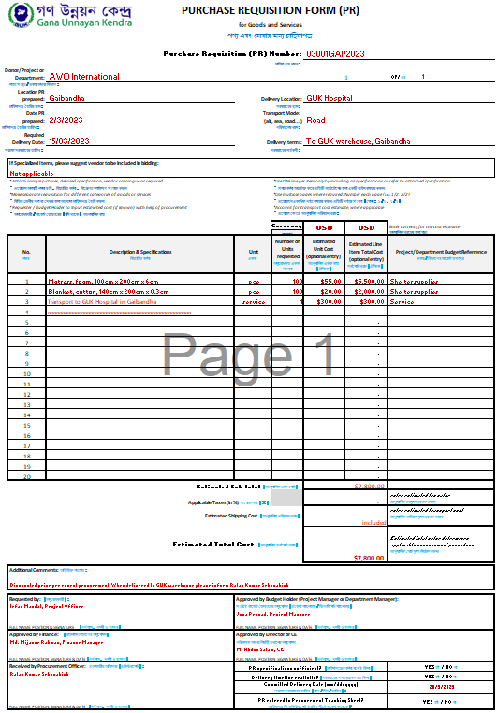
Purchase Requisition (PR)
To be filled by Requestor or Project Manager
To be given PR serial number (if not preprinted)
To be signed by all required authorized staff.
Notes: Project Manager/Dept. Manager can also be Requestor. Director and CE can sign on behalf Project Manager or Department Manager.
Not needed for utilities, incidentals and recurring charges based on the signed Contract or subscription.

Slide 31
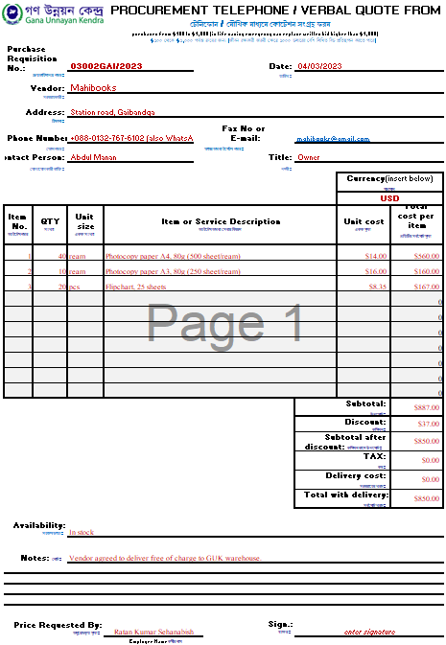
Procurement Telephone Quote Sheet $100-$1,000
To be filled and signed by Procurement Officer (anyone designated by management to carry out procurement activity).
One form per vendor, per quotation.
Can be done by telephone or by recording visit to the vendor.
Under $1,000 must be approved by the Budget Holder only if offer exceeds PR estimate. It can be verbal initially and signed after purchase is completed, not to slow down procurement.
3 phone, online or verbal bids recommended for purchases from $500 - $1,000.

Slide 32
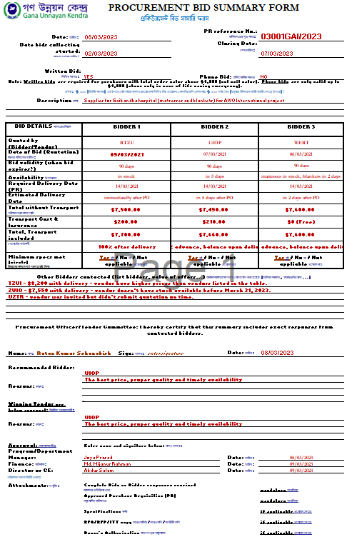
Procurement Bid Summary - PBS $1,000 - $20,000
It is summary of best bids (top 3). Other bids also noted on PBS and attached. Can be supported with detailed line by line Comparative Bid Analysis table, if necessary.
Recommendation made by Procurement Officer based on received offers.
Final management team decision has to be justified if different from the recommendation.
Over the value of $20,000 sealed bidding is required and therefore Procurement Committee Memo replaces PBS.

Slide 33
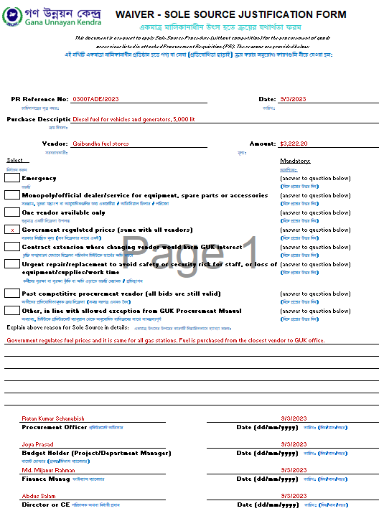
Waiver – Sole Source Justification over $1,000 when no competition
Any non-competitive bidding above $500 must be well justified and approved using Waiver – Sole Source Justification.
Reason for non-competitive bidding must be one among allowed within GUK Procurement procedure.
If reason for not doing competitive bidding is not among those allowed per GUK procurement procedure, Deviation from standard procurement competitive process must be requested and approved prior to proceeding with the order.

Slide 34
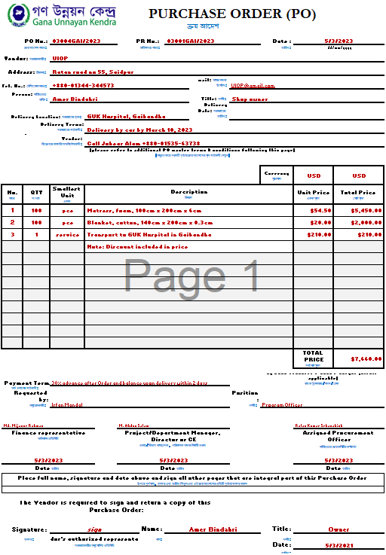
Purchase Order (PO)
PO is simplified Contract between organization and Vendor.
When PO is not sufficient to describe agreed terms, use Contract instead.
Documents agreed goods/services specification and QTY, price and delivery time and place.
Signature of the Vendor constitutes acceptance of the order.
Note applicable Terms and Conditions attached to PO.
Splitting order among vendors must be approved by the CE.

Slide 35
Material accounting
After procurement or donation of goods, material accounting for equipment and supplies is next important area of accountability for any organization.
For this reason, organizations are expected by assistance recipients, communities we serve and our funding sources to have in place the following:
Accurate and documented stock records for program supplies
Accurate and documented Asset List for equipment and shelter items
Accurate and documented inventory of furniture and small value equipment, etc.
Accurate and documented distribution or end use for all items.
All records must be reconciled regularly and periodically checked through scheduled and through surprise controls!
Losses and damages must be explained or investigated and documented.

Slide 36
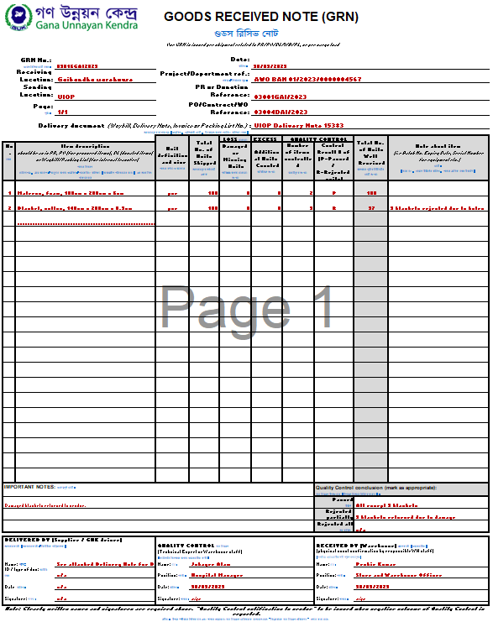
Goods Received Note - GRN
Control form for goods when received from:
Vendor
Donor
Internally
Evidence of accepted goods quantity and quality, and their receiving into the stock.
It is mandatory by all donors to have evidence of received quantity and quality control!
It is used to document receiving of goods for purchases from $500 and more.

Slide 37
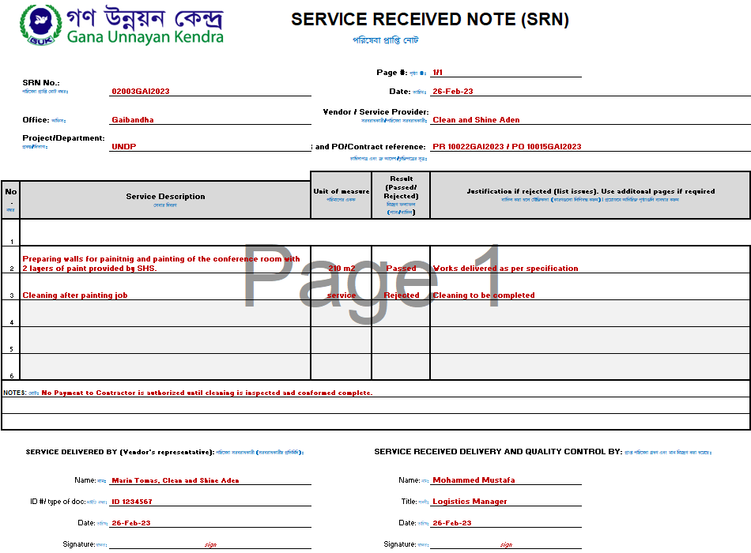
Service Received Note (SRN)
SRN is control form and evidence for service delivery and related quality check from $500 (or less, if there is issue with delivery).
Below $500 it can be replaced with stamp “Received”.

Slide 38
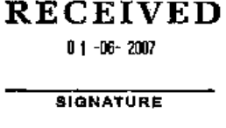
Dated stamp “Received” instead GRN/SRN
Goods receiving:
Goods delivered to the office rather than warehouse (any value), and small value Program Supplies under $500 can be confirmed as received with dated stamp “Received” on the Invoice, Delivery Note or Waybill, signed by the recipient.
GRN should be used instead if there are any issues with delivery.
Services receiving:
SRN can be replaced by stamp “Received” when no issues with service delivery under $500 and for any accommodation services or recurring monthly charges for service delivery under Contracts or subscriptions.

Slide 39
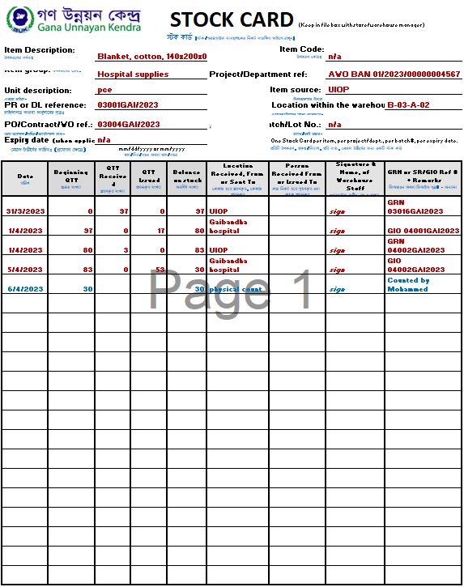
Stock Card
Kept at the Warehouse central file.
One card per item, per expiry date, per batch No., per project.
Needs to reflect the cumulative, current item stock balance in the warehouse accurately!
Has location of goods within the warehouse to help with easy and quick goods locating.
Must be updated as transaction occurs.

Slide 40
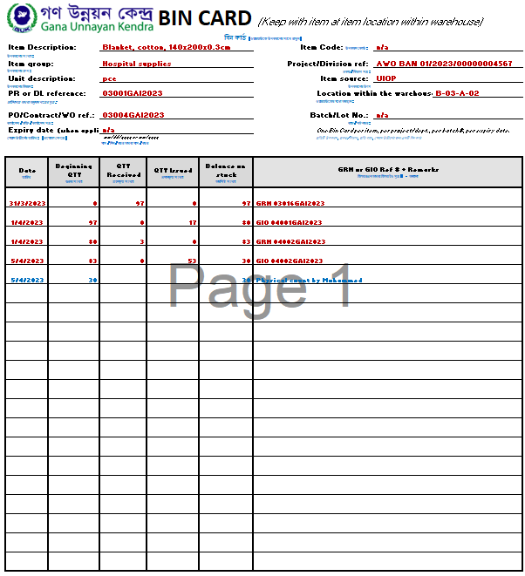
Bin Card / Stack Card
With the item, at the specific physical item location within the warehouse.
One per item, expiry date, batch and project.
Reflects balance for the item at the specific warehouse location.
Must be updated as transaction occurs.
Serves as additional stock balance check.

Slide 41
II. Issuing of goods from the Warehouse
Require Goods Issue Order (GIO) as task to warehouse staff to prepare items for dispatch to:
Internal transport to another warehouse site (Waybill).
Internal transport to distribution site (Waybill).
Individuals, in case of attractive item or assets such as phones, radios, laptops (use handover form).
Recipient institution or individual outside organization (use Donation Letter with Waybill or detailed Packing List for transfer of ownership to 3rd party).

Slide 42
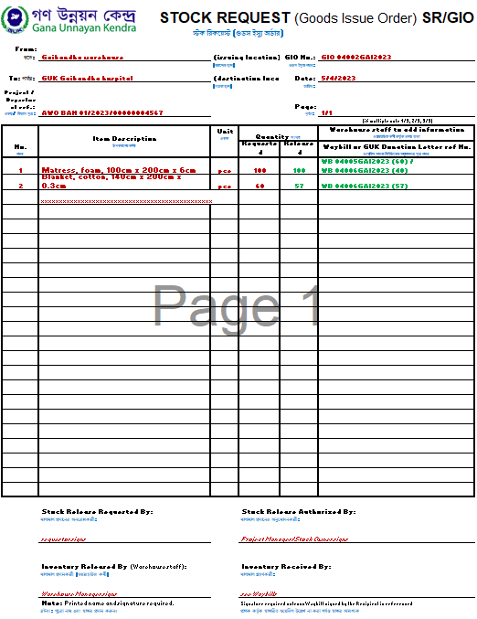
Stock Request/Goods Issue Order
To be filled by person Requesting release of goods or by Stock Owner/Project Manager.
Must be approved by authorized Stock Owner/Project Manager before issue of item/s from the warehouse/stock.
Serves to Warehouse Manager as task to pick, pack and prepare items for transport as well as to prepare transport documents (Waybills or Packing Lists).
SR/GIO requested QTY may be different than issued QTY.
One SR/GIO can result with several Waybills if more than one vehicle required for transport.

Slide 43
Transfer to organization internal distribution point
Example: Documenting Stock release to distribution:
Approved Goods Issue Order is filled and handed to Warehouse Manager after proper approval signature from the Stock Owner (i.e. Project Manager) as task to release requested goods.
Waybill is prepared to escort goods transferred to the distribution point and signed by driver who received goods for transport.
Waybill is signed after count by distribution point staff to document quantities and condition of received items.
Goods are entered in distribution point item balances as stock available for distribution.
Signed Waybill copy is returned to sender as delivery evidence.
Individual distributions to beneficiaries are registered through distribution records managed by the responsible staff at the distribution point.

Slide 44
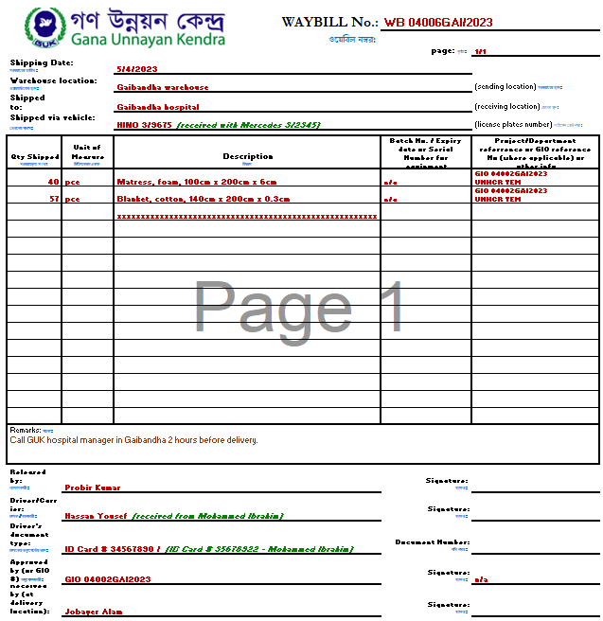
Transfer to another organization managed site
Always use Waybill to document any internal goods (or important documents) transfers.
Transfer all item relevant info to receiving location (i.e., description, expiry date, batch, project…).
Have Waybill signed by carrier and recipient at the destination as the evidence of transferred quantities and item condition.

Slide 45
Assets and Attractive Items issuing
Assets and Attractive Items must be entered into Asset List/Register as soon as received and kept safe and secure all time, with responsible person assigned.
Register (Asset List) serves for preparation of the mandatory Inventory Reports to donors end therefore must be regularly updated and kept accurate!
Every asset must have assigned Custodian (active staff).
Issuing Process:
Special form is used for recording handover of Asset / Attractive Items to the assigned Custodian.
Confirms the responsibility of the Custodian to keep and safeguard allocated items.
Registers return of items to the Issuing Officer.
Serves as record of items to be returned by the Custodian at the time of separation from the organization.

Slide 46
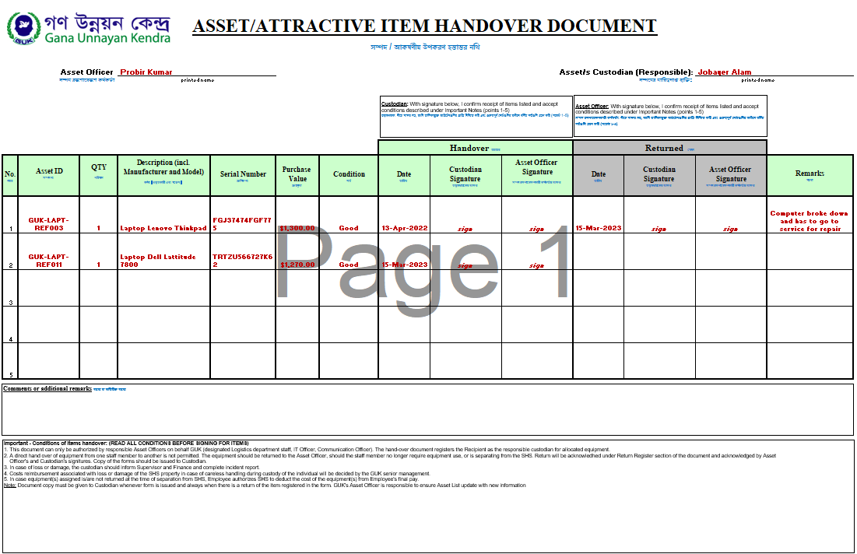
Assets and Attractive Items handover form

Slide 47
Closing remarks
Logistics/Procurement is there to support programs and operations as best we possibly can as the part of the larger TEAM.
Procurement and Logistics support is important foundation programs based on.
Eventual weakness in logistics or procurement will reflect on entire humanitarian operation and our organization.
We have to do our best to facilitate timely projects implementation while also observing our own policies and procedures, as well as donor and government rules and regulations!
Procurement and Logistics

Slide 48
Questions and discussion
This material is made possible by the generous support of the American people through the United States Agency for International Development (USAID). The contents are the responsibility of International Medical Corps and Concern Worldwide and do not necessarily reflect the views of USAID or the United States Government.
Notes:
Answer any question asked, time permitting. Ask people to write e-mail about any remaining question they may have and ensure answers are delivered timely.

